Slide 1
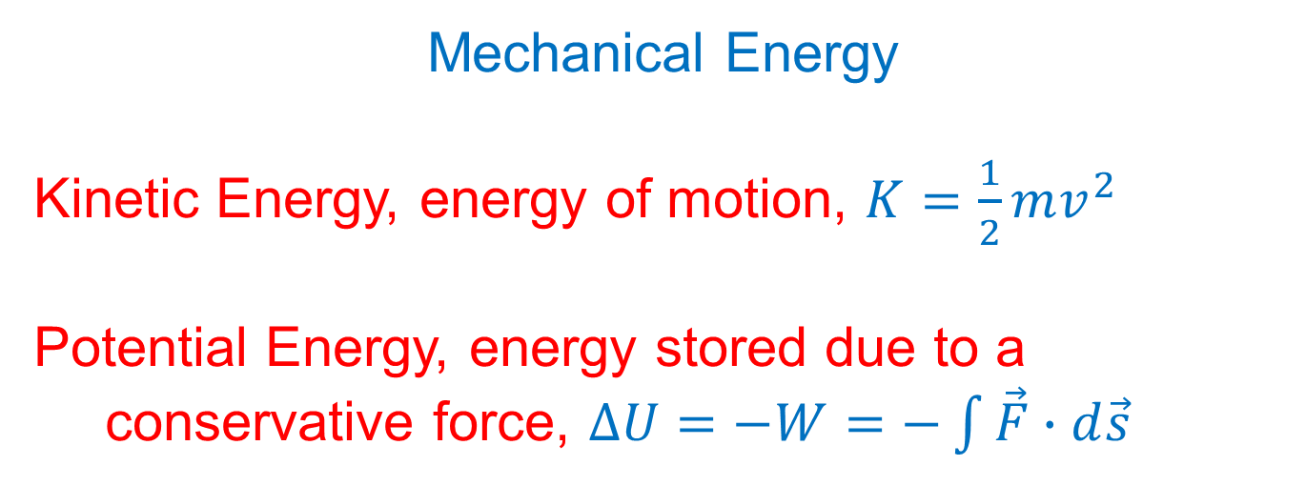
Mechanical Energy
Kinetic Energy, energy of motion, $K=\frac{1}{2}mv^{2}$
Potential Energy, energy stored due to a conservative force, $ΔU=−W=−\int{\vec{F}∙d\vec{s}}$

Slide 2
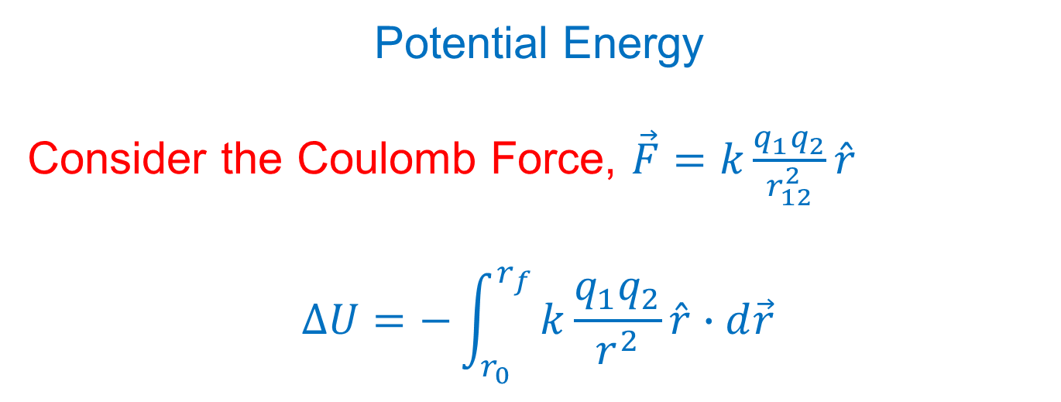
Potential Energy
Consider the Coulomb Force, $\vec{F}=k\frac{q_{1}q_{2}}{r_{12}^{2}}\hat{r}$
$$ΔU=−\int_{r_{0}}^{r_{f}}{k\frac{q_{1}q_{2}}{r^{2}}\hat{r}∙d\vec{r}}$$

Slide 3
Potential Energy
Consider the Coulomb Force, $\vec{F}=k\frac{q_{1}q_{2}}{r_{12}^{2}}\hat{r}$
$$ΔU=−\int_{r_{0}}^{r_{f}}{k\frac{q_{1}q_{2}}{r^{2}}\hat{r}∙d\vec{r}}$$
$$ΔU=−kq_{1}q_{2}\int_{r_{0}}^{r_{f}}{\frac{dr}{r^{2}}}$$
$$ΔU=Δ\left(k\frac{q_{1}q_{2}}{r}\right)$$

Slide 4
Potential Energy
Potential Energy due to Coulomb Force,
$$U=k\frac{q_{1}q_{2}}{r_{12}}$$
What happened to the Δ?
What does it imply about $U=0$?

Slide 5
Potential Energy
Potential Energy due to Coulomb Force,
$$U=k\frac{q_{1}q_{2}}{r_{12}}$$
Note: Potential Energy is a scalar!

Slide 6
Potential Energy
Potential Energy due to Coulomb Force,
$$U=k\frac{q_{1}q_{2}}{r_{12}}$$
Potential energy is the energy required to create a charge distribution by bringing in each charge from infinitely far away one at a time.

Slide 7
Potential Energy
Potential Energy due to Coulomb Force,
$$U=k\frac{q_{1}q_{2}}{r_{12}}$$
Potential energy is the energy required to create a charge distribution by bringing in each charge from infinitely far away one at a time.
What does it mean that a set of charges has positive (negative) potential energy?

Slide 8
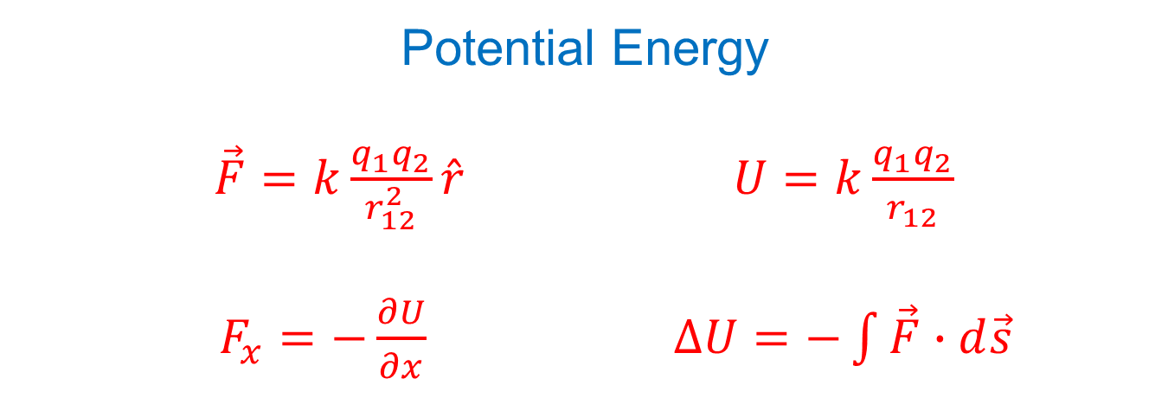
Potential Energy
$\vec{F}=k\frac{q_{1}q_{2}}{r_{12}^{2}}\hat{r}$ $U=k\frac{q_{1}q_{2}}{r_{12}}$
$F_{x}=−\frac{∂U}{∂x}$ $ΔU=−\int{\vec{F}∙d\vec{s}}$

Slide 9
Example: Calculate the electric potential energy of two protons separated by a typical proton-proton intranuclear distance of $2×{10}^{−15}\text{m}$.

Slide 10
Conservation of Energy
$$E_{f}−E_{i}={\left(W_{\text{other}}\right)}_{i→f}$$
($W_{\text{other}}$ refers to work done by non-conservative forces.)
If $W_{\text{other}}=0$, then
$$U_{0}+K_{0}=U_{f}+K_{f}$$

Slide 11
Example: Consider releasing two protons with a typical intranuclear separation of $2×{10}^{−15}\text{m}$. Assume they are only subject to the Coulomb Force. What maximum speed do the protons achieve? How far apart are the protons when they achieve maximum speed?

Slide 12
Point Charge in an Electric Field
$$ΔU=−\int{\vec{F}∙d\vec{s}}$$
$$ΔU=−q\int{\vec{E}∙d\vec{s}}$$
$$\frac{ΔU}{q}=−\int{\vec{E}∙d\vec{s}}$$

Slide 13
Electric Potential
(Electric potential energy per charge)
$ΔV=\frac{ΔU}{q}$ $ΔV=−\int{\vec{E}∙d\vec{s}}$

Slide 14
Electric Potential Energy (or Potential Energy)
$\vec{F}=k\frac{q_{1}q_{2}}{r_{12}^{2}}\hat{r}$ $U=k\frac{q_{1}q_{2}}{r_{12}}$
$F_{x}=−\frac{∂U}{∂x}$ $ΔU=−\int{\vec{F}∙d\vec{s}}$
Electric Potential (or Potential)
$\vec{E}=k\frac{q}{r^{2}}\hat{r}$ $V=k\frac{q}{r}$
$E_{x}=−\frac{∂V}{∂x}$ $ΔV=−\int{\vec{E}∙d\vec{s}}$
$$\vec{F}=q\vec{E}$$
$$ΔU=qΔV$$

Slide 15
Example: A proton is released in a region of space where there is an electric potential. Describe the subsequent motion of the proton.

Slide 16
Example: A proton is released in a region of space where there is an electric potential. Describe the subsequent motion of the proton.
Example: An electron is released in a region of space where there is an electric potential. Describe the subsequent motion of the electron.

Slide 17
Example: Determine the potential energy of a set of three charges.
q₁
q₂
q₃

Slide 18
Example: Determine the potential energy of a set of three charges.
$$U=k\frac{q_{1}q_{2}}{r_{12}}+k\frac{q_{1}q_{3}}{r_{13}}+k\frac{q_{2}q_{3}}{r_{23}}$$
q₁
r₁₃
r₁₂
q₂
r₂₃
q₃
Electric potential energy, U, comes from the interaction of pairs of charges. Add potential energy of each pair of charges.

Slide 19
Example: Determine the potential of a set of three charges.
q₁
q₂
q₃

Slide 20
Example: Determine the potential of a set of three charges.
$$V=k\frac{q_{1}}{r_{1}}+k\frac{q_{2}}{r_{2}}+k\frac{q_{3}}{r_{3}}$$
P
q₁
r₁
r₃
r₂
q₂
q₃
Electric potential, V, comes from individual charges. Add potential of each individual charge.

Slide 21
Example: Calculate the electric potential energy of the given set of three charges.
-q₀
d
q₀
4d
d
2q₀

Slide 22
Example: Calculate the electric potential at point P due to the given set of three charges.
-q₀
P
d
q₀
4d
d
2q₀

Slide 23
Units
U is measured in joules (J).
V is measured in volts (V) where $1\text{V}=\frac{1\text{J}}{1\text{C}}$
The units of E are $\frac{\text{N}}{\text{C}}$ $\left(E=\frac{F}{q}\right)$ or $\frac{\text{V}}{\text{m}}$ $\left(E_{x}=−\frac{∂V}{∂x}\right)$.

Slide 24
Units
U is measured in joules (J).
V is measured in volts (V) where $1\text{V}=\frac{1\text{J}}{1\text{C}}$
The units of E are $\frac{\text{N}}{\text{C}}$ $\left(E=\frac{F}{q}\right)$ or $\frac{\text{V}}{\text{m}}$ $\left(E_{x}=−\frac{∂V}{∂x}\right)$.

Slide 25
Units
U is measured in joules (J).
V is measured in volts (V) where $1\text{V}=\frac{1\text{J}}{1\text{C}}$
The units of E are $\frac{\text{N}}{\text{C}}$ $\left(E=\frac{F}{q}\right)$ or $\frac{\text{V}}{\text{m}}$ $\left(E_{x}=−\frac{∂V}{∂x}\right)$.

Slide 26
Units
Electron volts (eV) are another unit of energy. An eV is the energy gained by a proton moving through a potential difference of 1 V.
$$ΔU=qΔV$$
$$1\text{eV}=(1.6×{10}^{−19}\text{C})(1\text{V})$$
$$1\text{eV}\text{=1.6}×{10}^{−19}\text{J}$$

