Slide 1
Thin Lenses
MS&T Physics 2135, Lab O6

Slide 2
Objectives
Verify the thin lens equation and measure the focal length of a converging lens.
Note: There is a possibility that you may encounter a virtual object or image (negative s or s’) in set-up 3. Stick to the sign conventions (see next slide) and the math will usually work out properly. That said, there are several sources of error that can cause problems and should be discussed in your conclusions. For instance, you may want to investigate spherical aberration to learn more.

Slide 3
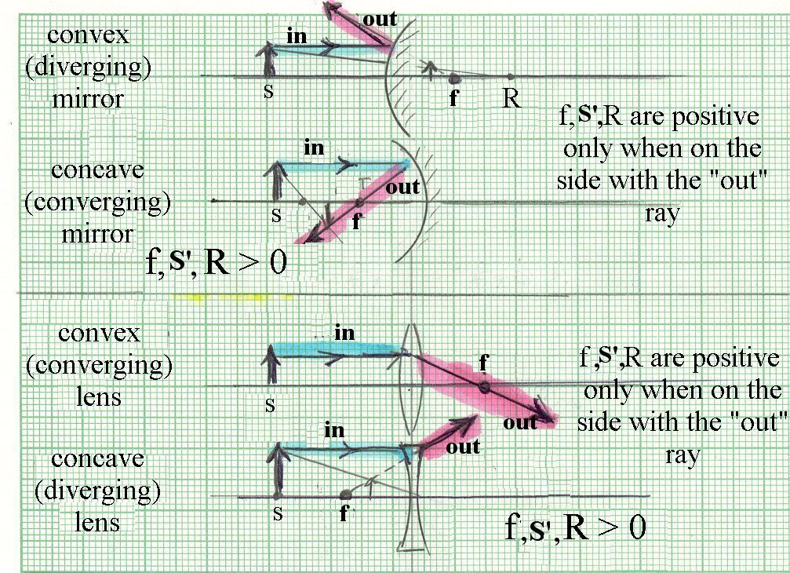
Sign Conventions: Dr. Hale’s Card

Slide 4
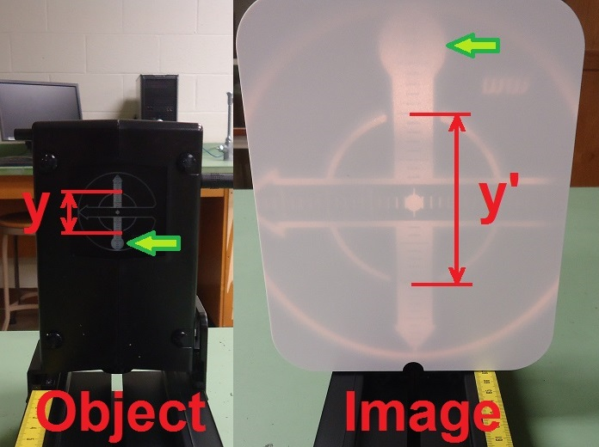
Heights and Magnification
Heights are positive if upright, and negative if inverted.
In this picture, y is positive and y’ is negative. Note the circles (indicated by the green arrows) are in opposite locations.

Slide 5
Set-up 1 and Set-up 2
In the picture, as is convention in ray tracing, light travels from left to right.
Find two different sets of object/image distances for a single screen position. One is set-up 1, the other is set-up 2.

Slide 6
Set-up 3
Having two lenses can make finding an image somewhat more difficult.
Typically it helps to start with the screen as far away from the object as possible. From there, you can move the screen and lenses as needed.

