Slide 1
Generator
MS&T Physics 2135, Lab O5

Slide 2
Objectives
Study a generator powered by a falling mass.
Find the efficiency of the generator by examining how the potential energy stored in the hanging mass is converted to electrical and kinetic energy.
Note: The generators you will be using today have a thin metal shaft connecting the magnet to the pulleys. This shaft is easily bent, so please be very careful not to damage the generators. Also, please do not let the mass hangers hit the floor; they have been known to break from the impact. Use the yellow foam pad.

Slide 3
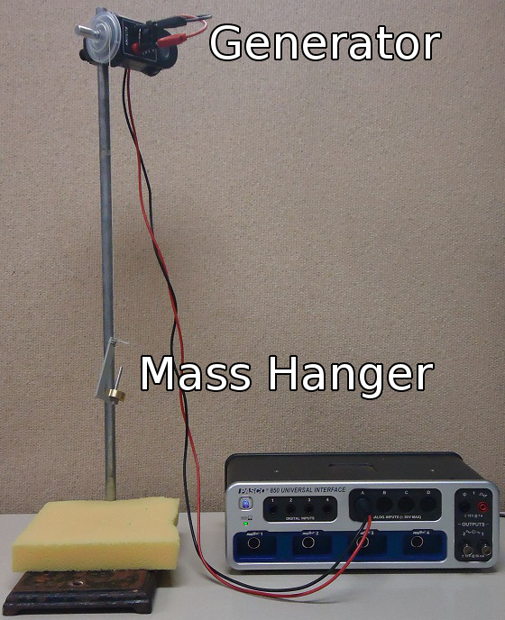
A Note on Height
In this experiment, we need to know how far the mass falls while still driving the pulley.
That means the h in potential energy may be the length of the string or the actual fall height. You decide which!

Slide 4
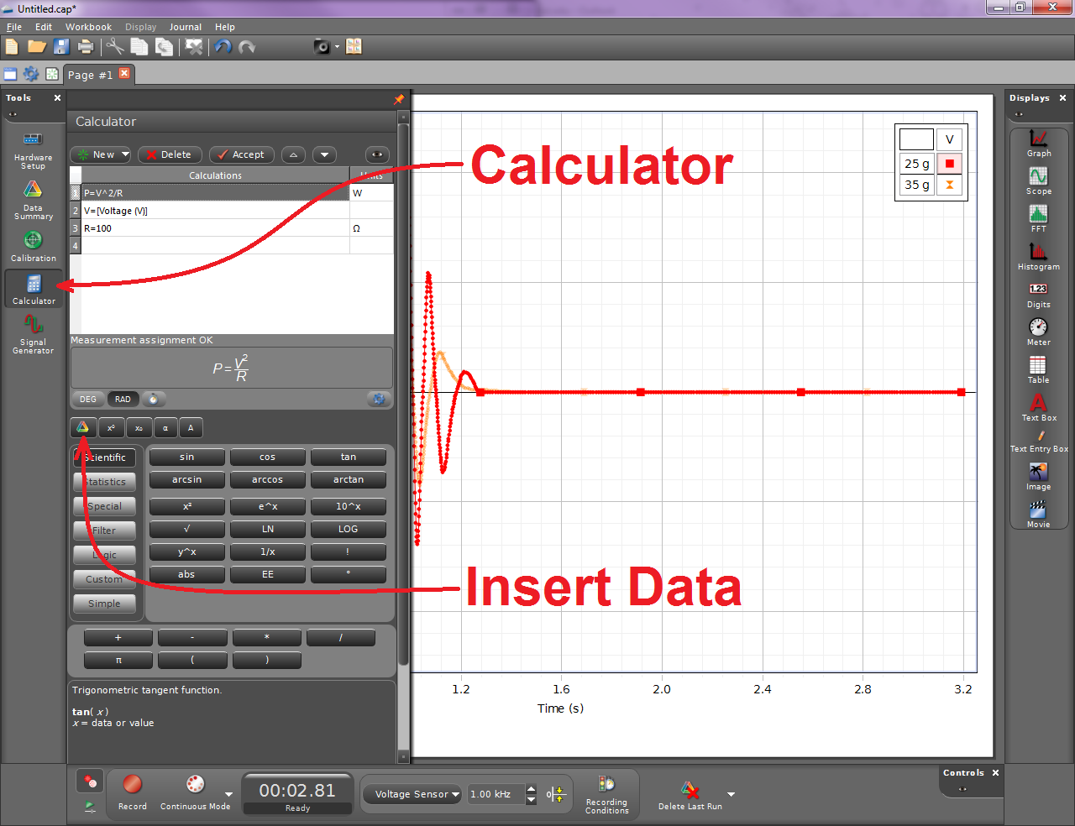
Adding a Calculation in Capstone
Click the Calculator tool
Type in the formula and click Accept or hit enter.
Using the Insert Data button, define V to be your voltage probe measurement.
Define R=100.
You can specify units for P and R by clicking in their Units boxes. Right click to find the Ω symbol.

Slide 5
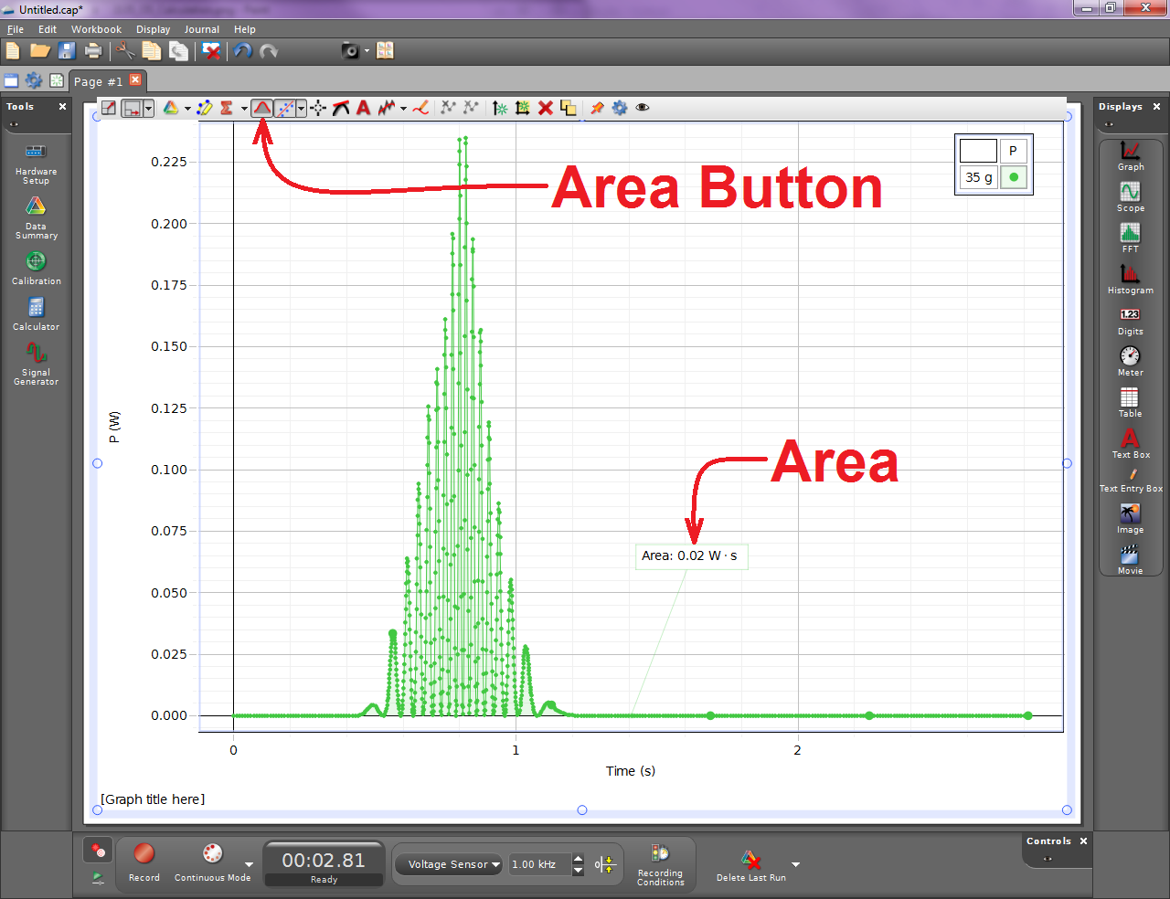
Calculating Area in Capstone
Set up a graph to plot your power calculations.
Click the Area button to display the area under the curve in a box.
You can move the box as you see fit.
Note: The units are based on what you specified when you set up your calculation.

