Slide 1
Current Balance
MS&T Physics 2135, Lab E4

Slide 2
Objectives
Use a current balance to determine the magnitude and direction of the force between two parallel current-carrying wires.
Use your measurements to determine μ_{o}, the permeability of free space.
Question of the day: If B varies directly with I and F varies jointly with I and B, how does F vary with I?
Note: When plotting data, your dependent variable is x and your independent variable is y. Fitting a linear trendline gives you y=mx+b. This allows you to compare your theoretical equation to the trendline to find an experimental value for any parameter in the equation. This is how you will find μ_{o} today.

Slide 3
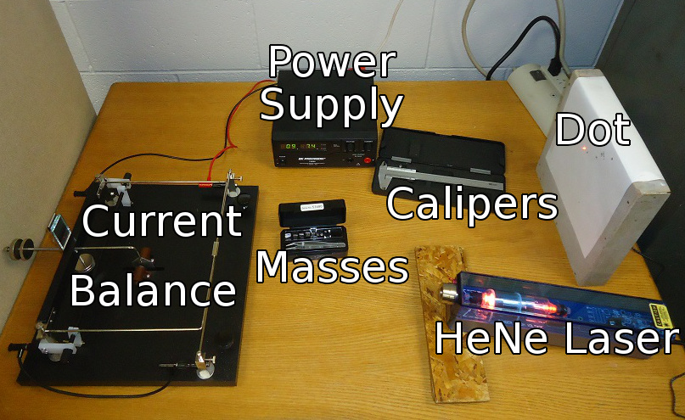
Materials Used

Slide 4
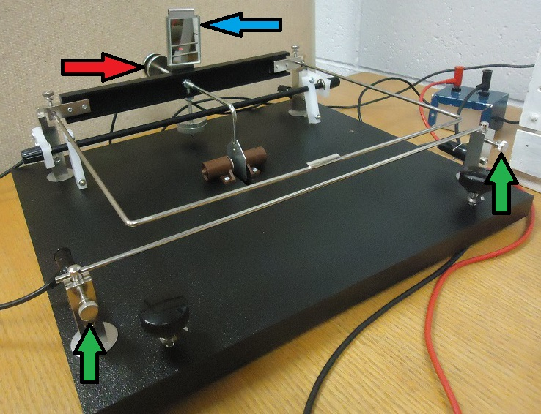
The Current Balance
The mirror (blue arrow) reflects the laser beam, which moves as the separation distance changes.
Set the separation distance with the balance wheels (red arrow) or by loosening the thumb screws (green arrows) and moving the bottom wire. Turn the current off before you make any adjustments!
Mark the zero-current position of the laser dot on the paper.

Slide 5
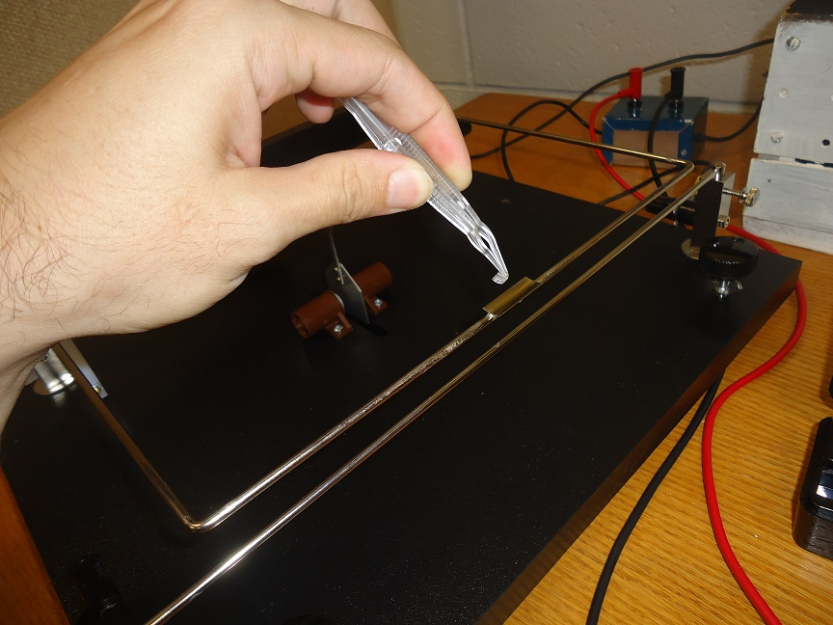
Adding Masses
Using the tweezers, select a mass to add to the tray. This decreases the separation distance.
Increase the current until the dot returns to its zero-current position.
Record the current displayed on the Power Supply. DON’T EXCEED 15A!!!!
Repeat for several masses/distances.
Note: The lab manual directs you to calculate current from a DMM voltage measurement. This was the procedure with our old power supplies. Disregard that, and use the current indicated on the supply.

