Slide 1
Resistance of a Diode
MS&T Physics 2135, Lab E3

Slide 2
Objectives
Determine how the resistance of a diode varies with both the direction and the magnitude of the current.
Note: You will need to decide how much data to collect today; there is no “right” answer. Guidelines are provided below, but the final decision is yours.

Slide 3
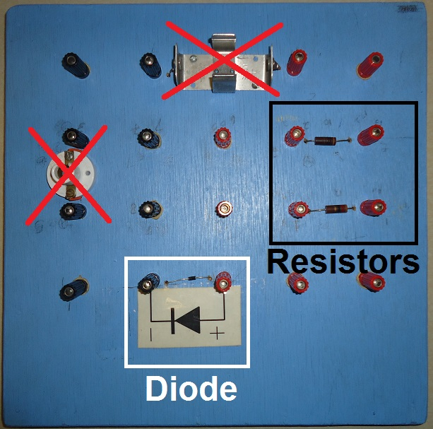
The Blue Board Explained
The two components in the black box are resistors. Choose one and measure its resistance.
The component in the white box is the diode. As pictured, it will allow current to pass through it from right to left, but not from left to right.
The other components (bulb socket and battery clip) are unused in this lab. There are no connections between the rest of the terminals on the board.

Slide 4
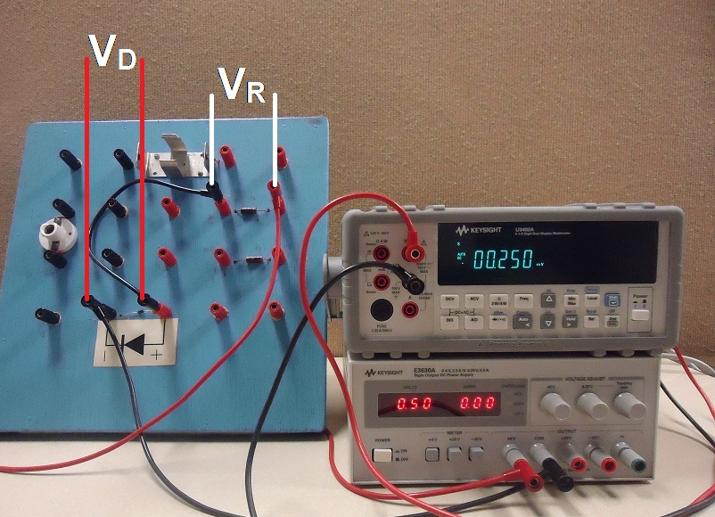
Assembled Circuit
Current path: +6V to resistor, resistor to diode, diode to COM.
Connect the DMM leads across the resistor to measure V_{R} and across the diode to measure V_{D}.
To reverse bias the diode, swap the wires at the power supply.

Slide 5
How Much Data Do You Need?
I_{D}
An ideal diode blocks current until the turn on voltage V_{TO} is reached, then passes current unimpeded.
A real diode turns on gradually, then has nonzero resistance.
Take some data, then make your table and plot.
Take further data until you can clearly see the diode’s behavior as V_{D} first approaches, then exceeds V_{TO}. Thoroughly test the reverse bias behavior as well.
V_{D}
V_{TO}
Reverse Bias
Forward Bias

