Slide 1
Capacitors
MS&T Physics 2135, Lab E2

Slide 2
Objectives
Understand the basics of parallel plate capacitors
Note: We will achieve this objective by making a simple parallel plate capacitor, which we then roll up to make it easier to handle. This doubles the capacitance. Remember that any time you are calculating a capacitance for a rolled capacitor, you must multiply by two.

Slide 3
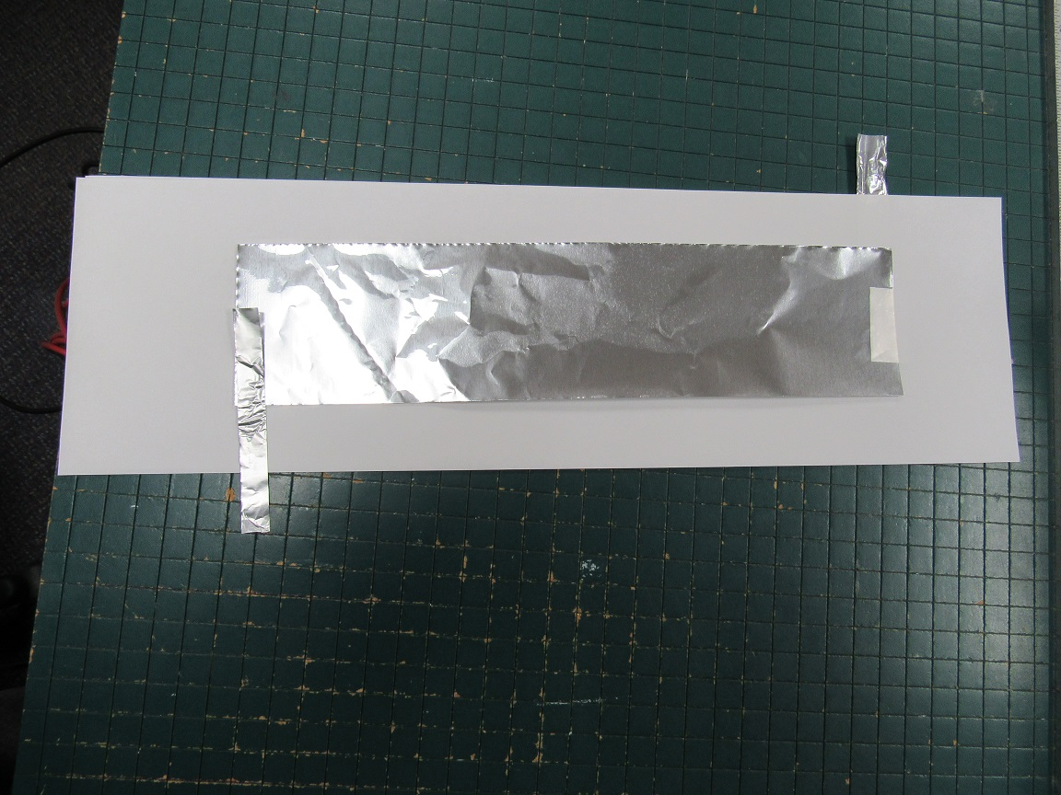
Stacking the Layers
Attach an electrode to each plate and stack as shown. This is now a parallel plate capacitor.
Tape changes both d and κ; use sparingly!
This is now a parallel plate capacitor.

Slide 4
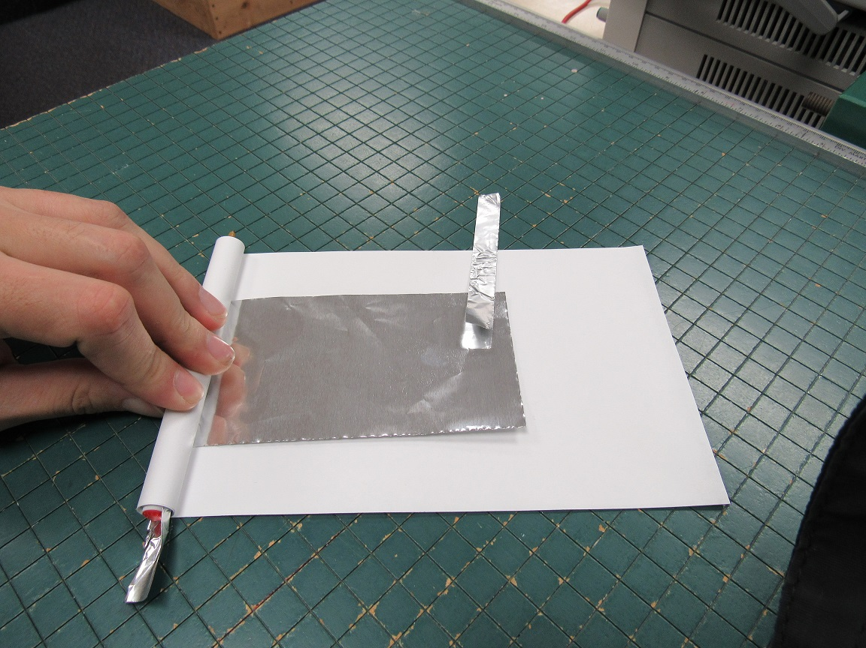
Rolling the Capacitor
Tape one side to a pencil.
Roll as tightly as possible, as shown.
Once rolled, you can twist the pencil to tighten the capacitor.
Tape the edge down. You now have a rolled capacitor: C_{rolled} = 2*C_{parallel}

Slide 5
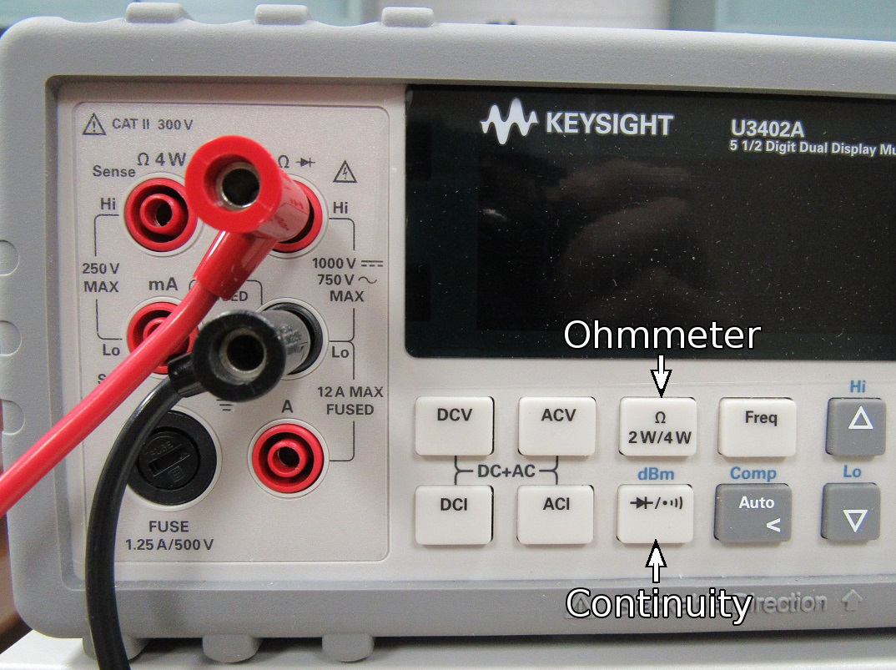
Checking for Shorts
With your DMM in ohmmeter mode, measure the resistance of your capacitor. You should get a very high resistance (MΩ or overload).
Alternatively, with your DMM in continuity mode, connect a lead to each electrode. If it beeps, you have a short.

Slide 6
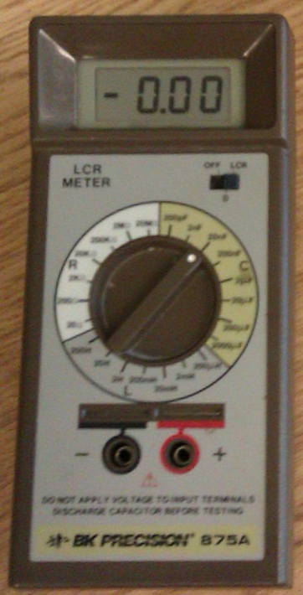
Using the LCR Meter to Measure C
Connect one lead to each electrode and set the switch to LCR.
The range is determined by turning the dial. You will likely need it set to 20nF, which means the meter displays the measurement in nF (10⁻⁹) and will measure up to 20nF.
You are measuring C_{rolled}; do not double it.
There are many sources of error in this process. Discuss as many as you can think of in your conclusion.

