Slide 1
Equipotentials and Electric Fields
MS&T Physics 2135, Lab O2

Slide 2
Objectives
Identify equipotential lines for a configuration of conductors.
Understand the relationship between equipotential lines and electric field lines
Note: You should sketch a guess of what the equipotential lines of your particular arrangement of electrodes will look like before you get started.

Slide 3
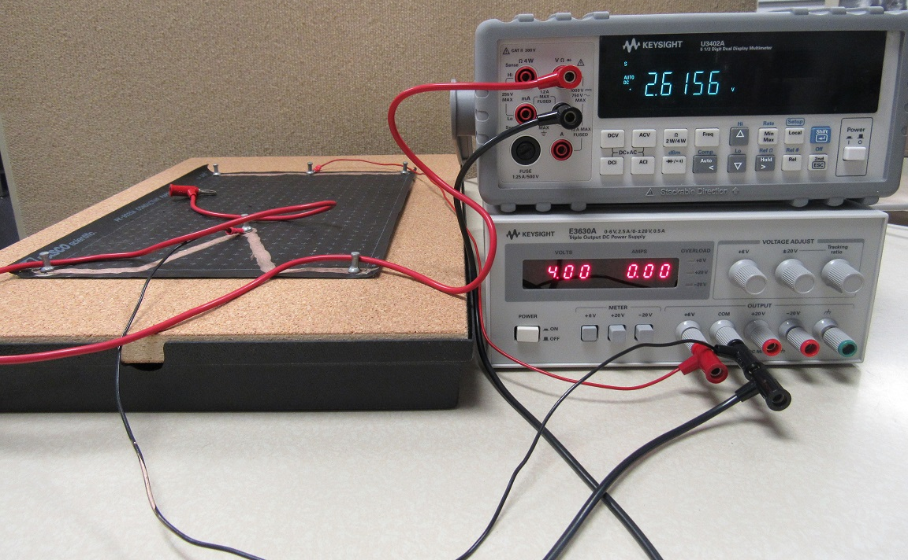
Experimental Setup
The red DMM lead is used as a voltage probe.
The black DMM lead is connected to the Power Supply’s COM port.
Here, V_{PS} = 4V. You can choose anything between 1V and 5V.

Slide 4
Creating a Field Between the Conductors
One conductor is connected to the +6V port of the Power Supply. Here, it’s the one at right.
The other conductor (at left) is connected to COM.
The electrodes are pinned to the center of the conductors to minimize error.
Mark the electrode and conductor locations on the engineering paper!

Slide 5
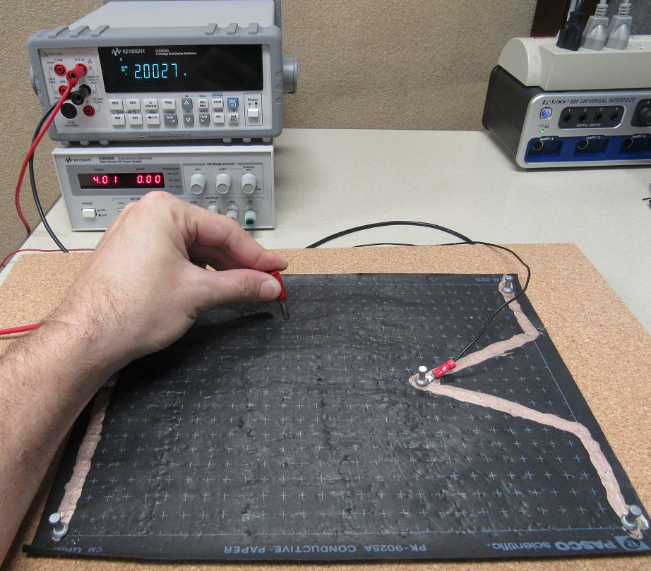
Marking Points to Construct Equipotential Lines
Using the banana clip on the red DMM lead, find a point at the desired voltage. Press firmly to make a mark.
Make several marks all at the same voltage to allow an equipotential line to be constructed.
Repeat for several voltages. You want a clear picture of the field, so pay close attention to regions of rapid change (i.e. pointy parts)!

Slide 6
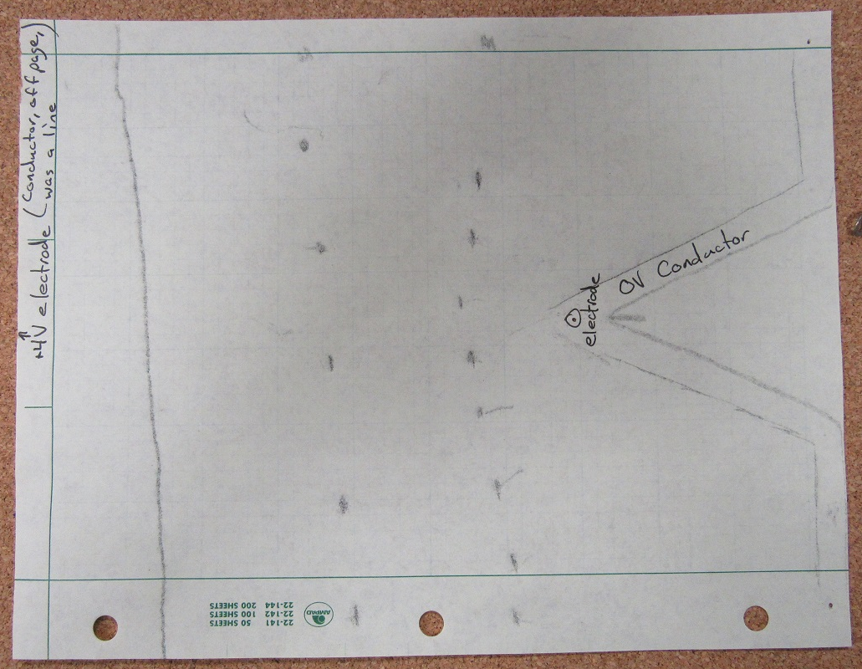
Example of Marks Made
The electrodes and 0V conductor are marked. The +4V conductor was off page, which is noted.
The line at left was made by pressing the probe while continuously tracing points at +3V. This works, but is error-prone. Dots are preferred.
Note: This diagram is incomplete! It needs more equipotentials near the 0V electrode.

Slide 7
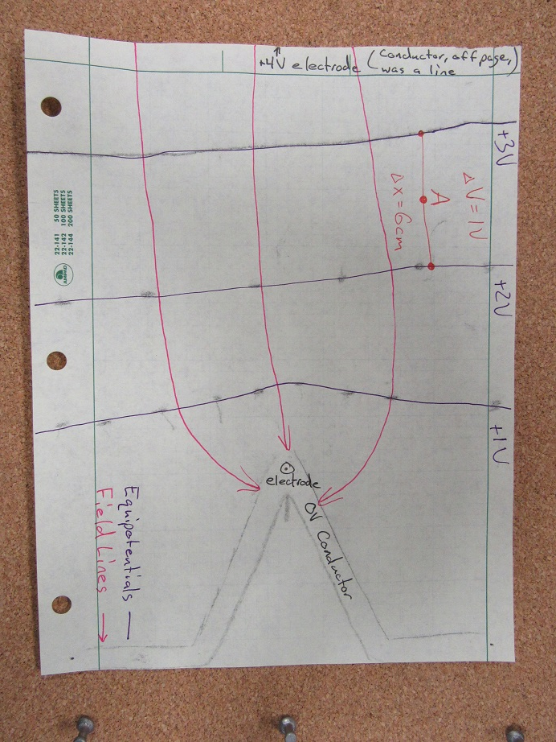
Equipotentials, Field Lines, and Calculation of E at Point A
Equipotential (purple) and field (pink) lines have been drawn.
Point A has been chosen and ΔV and Δx have been noted (red).
Make the equipotential and field lines distinguishable.
Note: This diagram is incomplete. It should have more field lines.

