Slide 1
Instrumentation & Root Mean Square Voltage
MS&T Physics 2135, Lab E1

Slide 2
Objectives
Review Laboratory Report Format
Review use of Capstone, our data acquisition software and hardware for electrical and magnetic measurements.
Learn to use a Digital Multimeter (DMM).
Learn about AC root mean square (RMS) voltages.
Note: You must provide several sections for each lab report in this class. Details regarding what information belongs in each of these sections can be found in the “General Information” section at the beginning of your lab manual. If you have any questions that are not answered there, consult your lab instructor.

Slide 3
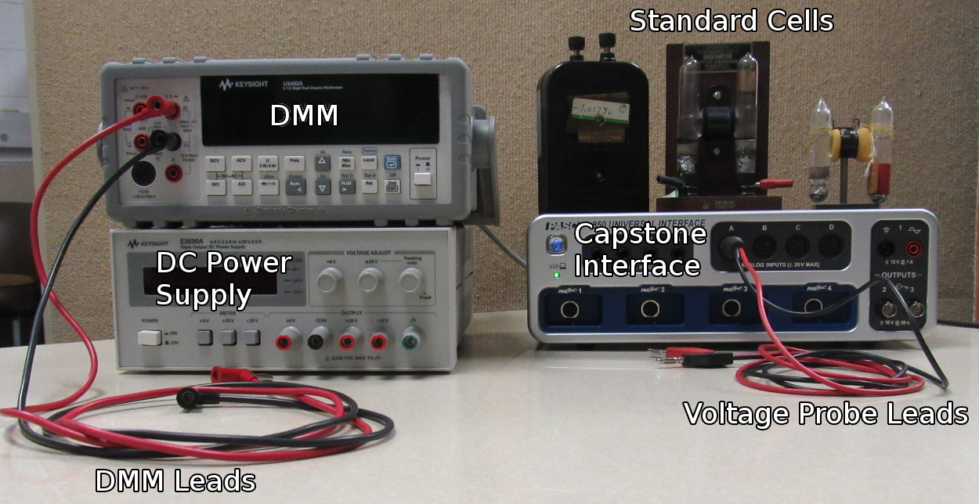
Equipment Used
Here is a labeled picture of the equipment you will use today.

Slide 4
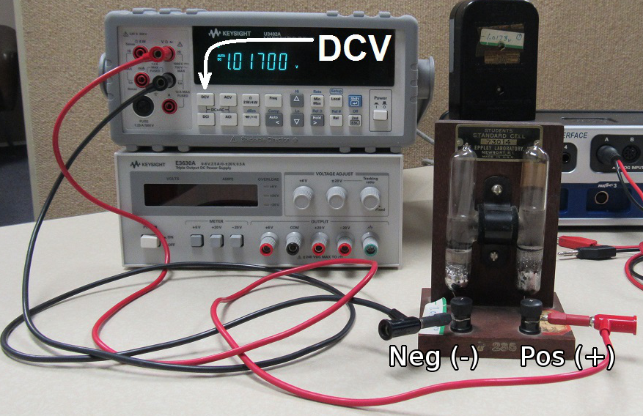
Measuring Standard Cell
Connect the DMM to the Standard Cell.
Turn on the DMM and press the DCV button to measure DC voltage.
Be nice to the standard cells: some of them are older than your parents!

Slide 5
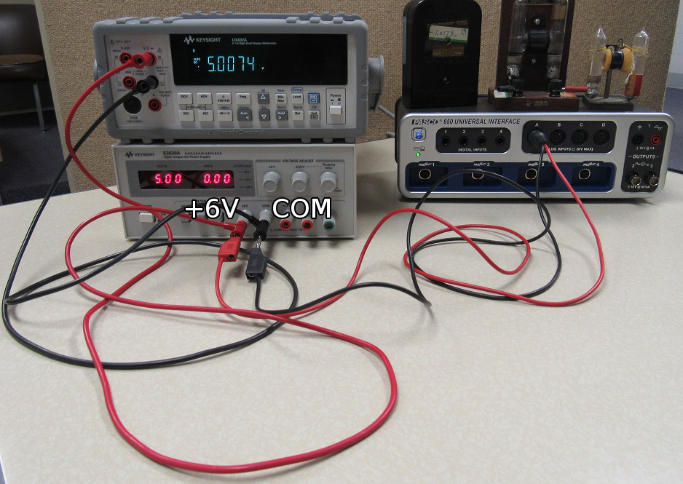
Measuring DC Power Supply
Connect the DMM (still in DCV mode) to the +6V and COM terminals of the DC Power Supply.
Connect the Capstone Voltage Probe to the DMM leads.

Slide 6
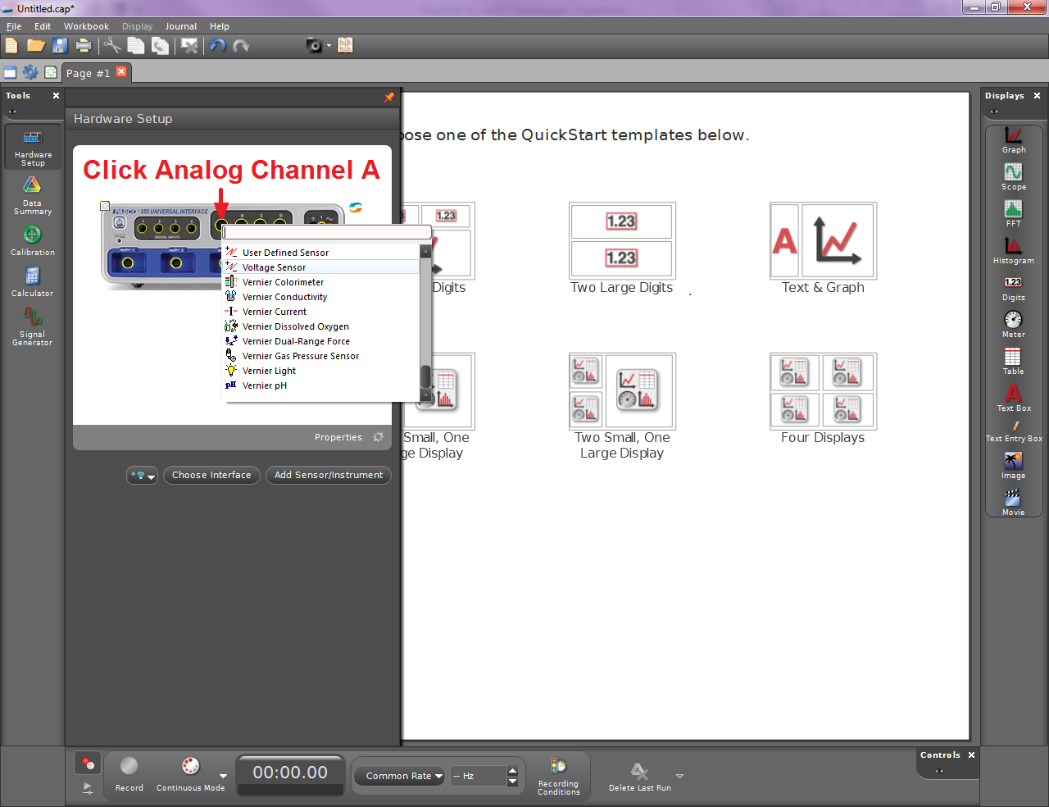
Measuring DC Power Supply
The pane on the left in Capstone changes based on which tool is selected.
Clicking the currently selected tool hides the pane from view.
Select the Hardware Setup tool and add the Voltage Sensor to the experiment.

Slide 7
Measuring DC Power Supply
Hide the left hand pane.
There are several display presets, but right now we want a single digital readout.
Click Record. Write down the DMM and Capstone readings.
Turn off the power supply and delete the digits display (right click and choose delete).

Slide 8
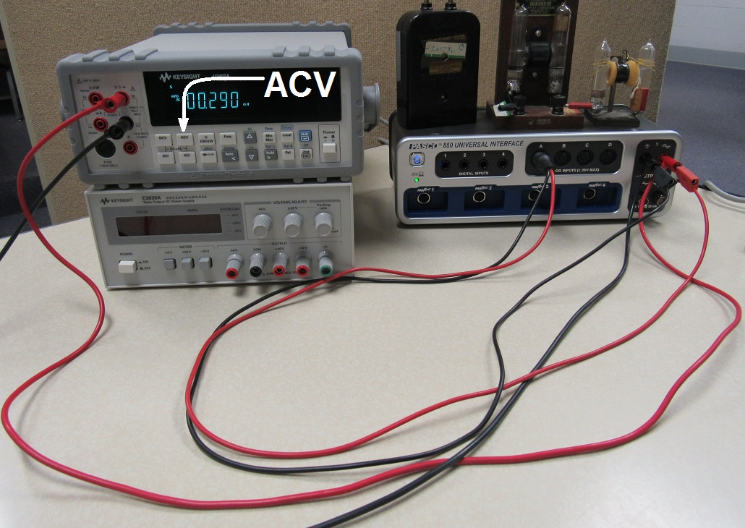
Measuring AC Waveforms
Connect the leads from both the DMM and the voltage probe to Output 1 of the Signal Generator on the 850 Interface.
Press the ACV button on the DMM to measure AC voltage.

Slide 9
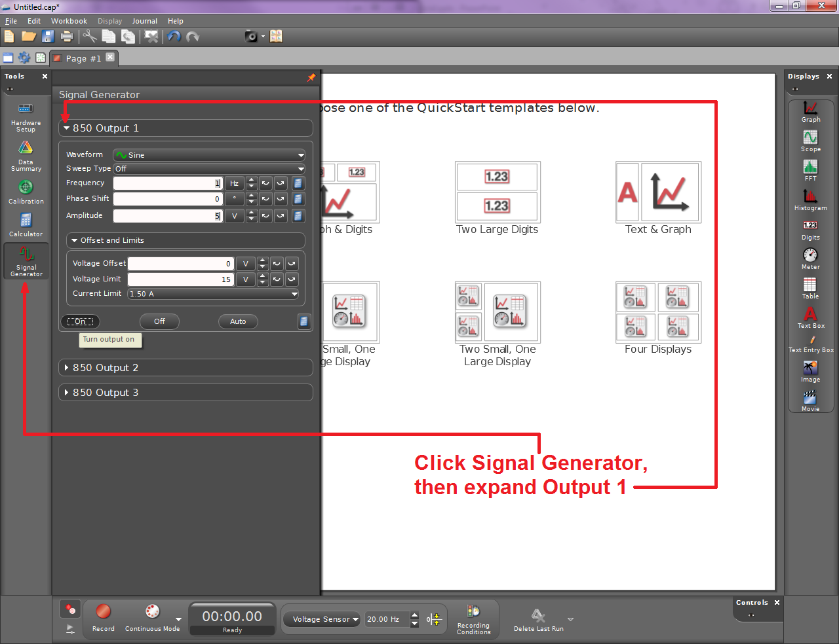
Measuring AC Waveforms
Select the Signal Generator tool to configure the output signal.
Specify the waveform, frequency, and amplitude as indicated in the lab manual.

Slide 10
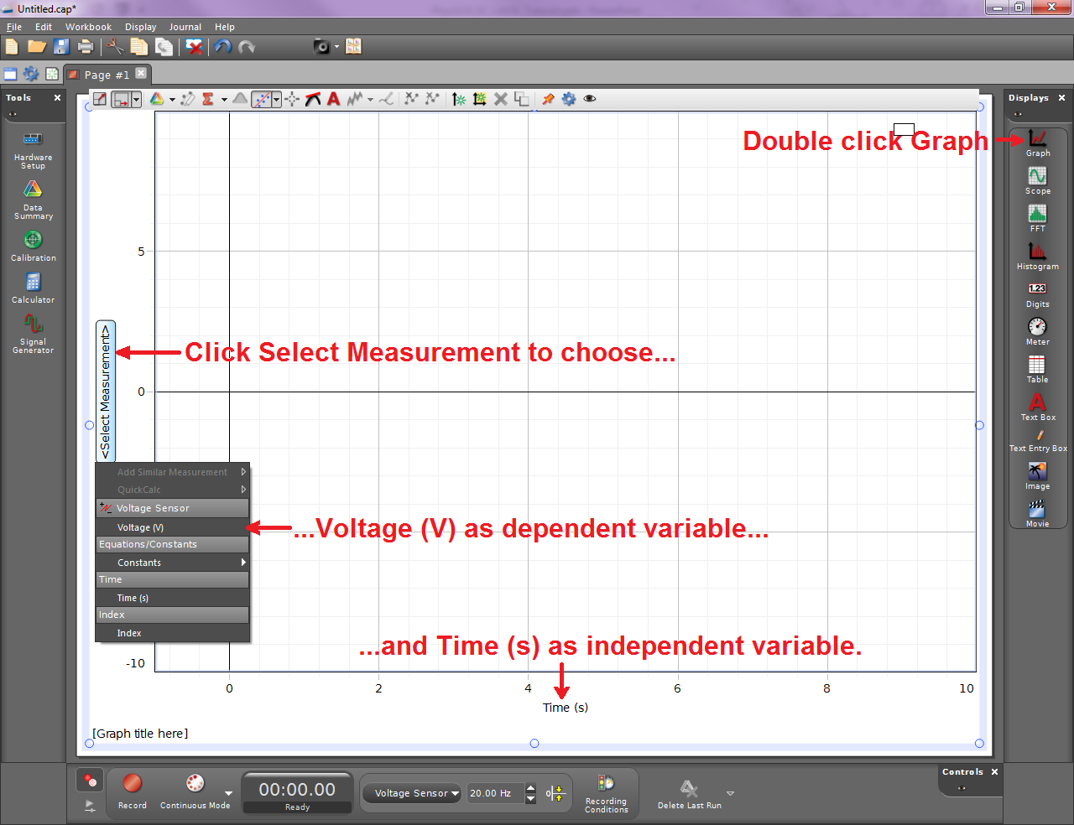
Measuring AC Waveforms
Hide the left hand pane.
Add a single graph and configure it to plot Voltage vs time.

Slide 11
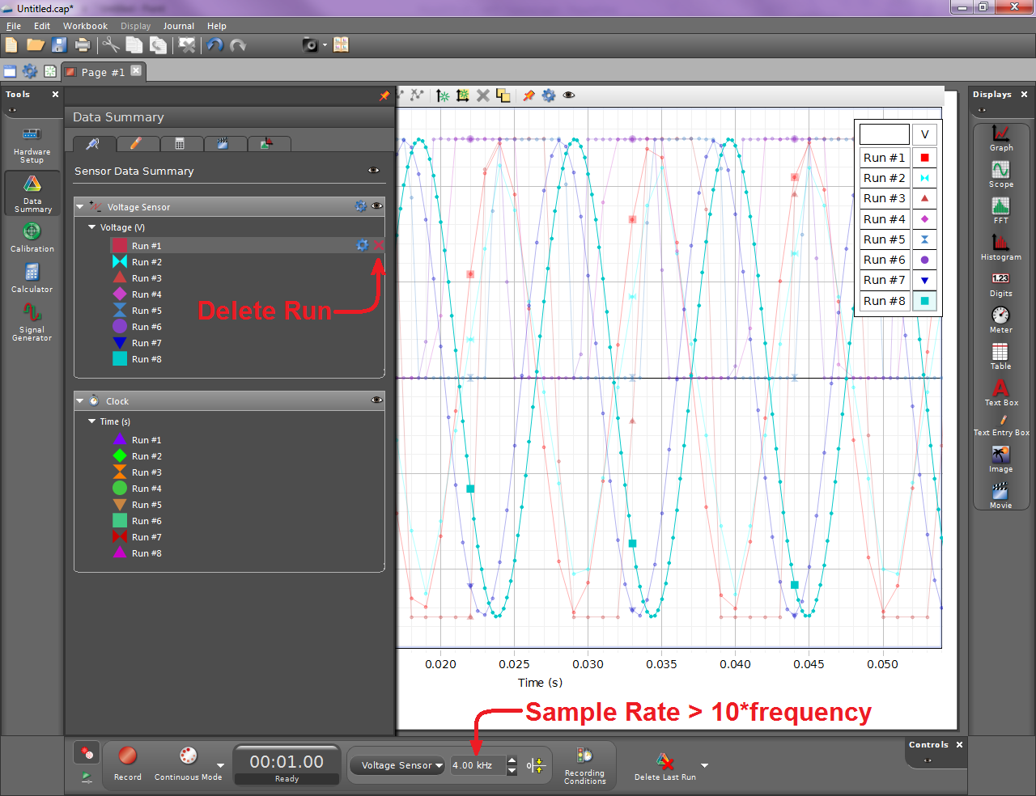
Measuring AC Waveforms
Specify an appropriate sample rate. The higher the sample rate, the smoother your data will look.
Record voltages from the DMM as well as in Capstone for each of the waveforms indicated.
You can delete runs with the Data Summary tool.

Slide 12
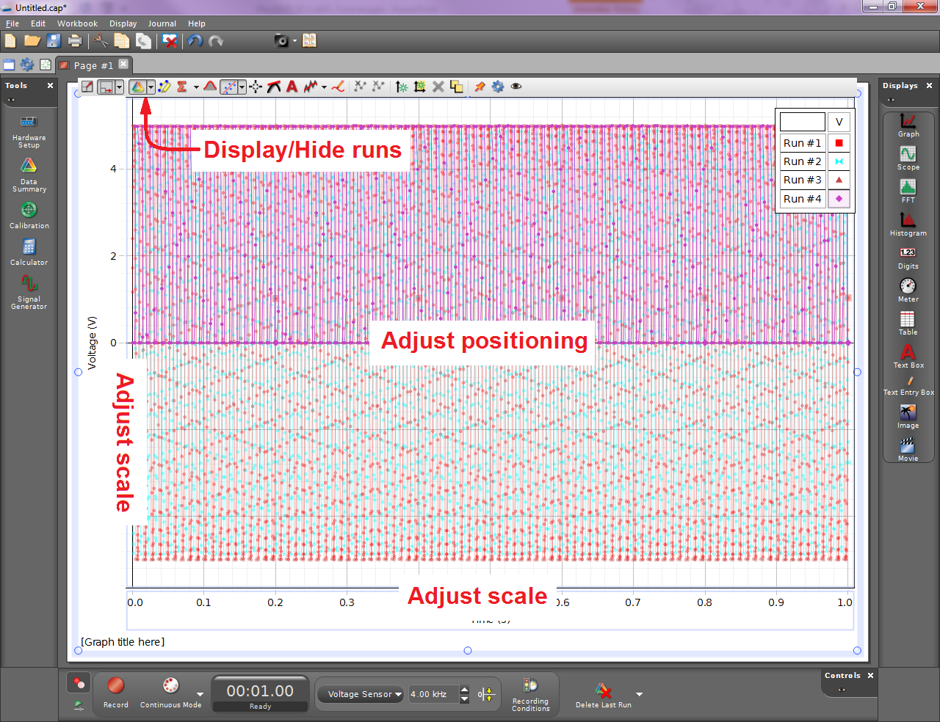
Measuring AC Waveforms
Your plots will look something like this.
Adjust the scale and position of the plot by clicking and dragging in various places. Experiment!
Put individual plots of a couple cycles of each waveform in your lab report.

Slide 13
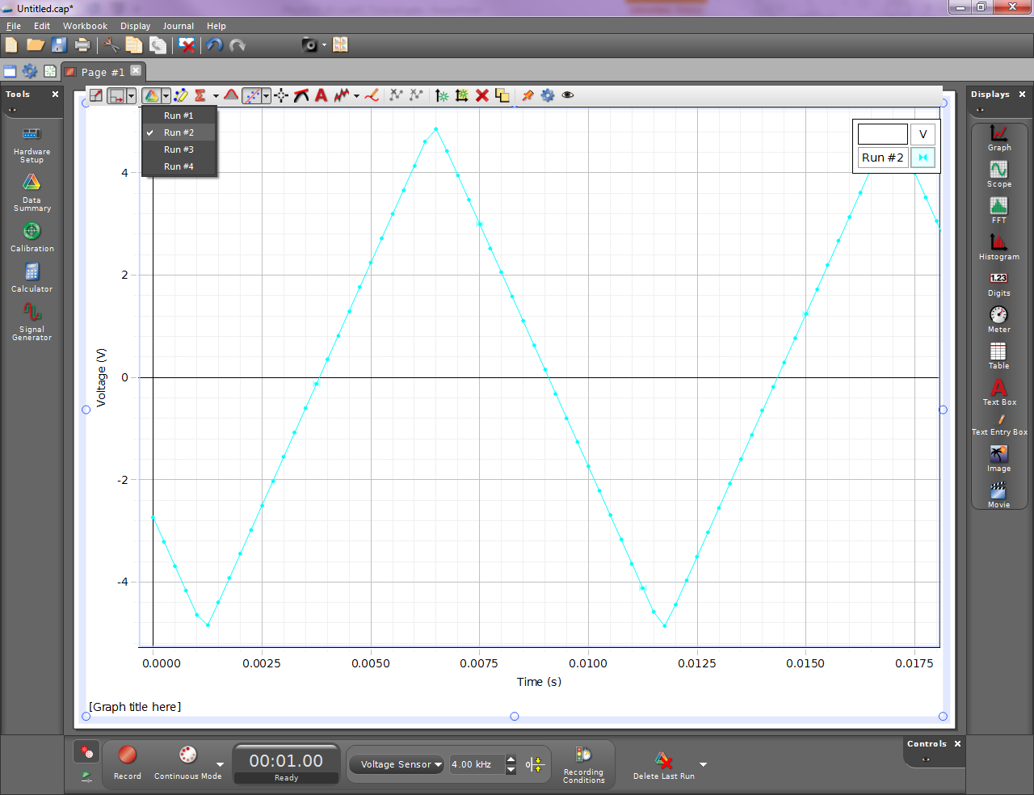
Measuring AC Waveforms
Here’s an example of a well-scaled plot.
Remember that your plots will print in black and white. Don’t rely on color to distinguish runs!
Don’t forget to write your introduction and conclusion, and add any diagrams indicated in the report.

Slide 14
Notes on Analysis
Percent error: $\left|\frac{accepted−measured}{accepted}\right|∗100$
Percent difference: $\left|\frac{V_{DMM}−V_{PS}}{\frac{1}{2}\left(V_{DMM}+V_{PS}\right)}\right|∗100$
When calculating V_{RMS} for the sine wave, perform the calculation symbolically. Remember that the period T is the inverse of the frequency f. Do you see anything that will cancel? Simplify your answer before plugging in numbers!
In the last question, you don’t have to integrate to find V_{RMS} for the other waveforms. In fact, each waveform follows a different V(t) function, so they all require different integrals that are not given in the lab manual. Instead, answer this question based on what you learned in the previous question.

