Slide 1
Coulomb’s Law and Using PASCO Capstone
MS&T Physics 2135, Lab O1

Slide 2
Objectives
Review Laboratory Report Format.
Apply Coulomb’s Law to a simple geometry and calculate results.
Review use of Capstone, our data acquisition software and hardware for electrical and magnetic measurements.
Note: You must provide several sections for each lab report in this class. Details regarding what information belongs in each of these sections can be found in the “General Information” section at the beginning of your lab manual. If you have any questions that are not answered there, consult your lab instructor.

Slide 3
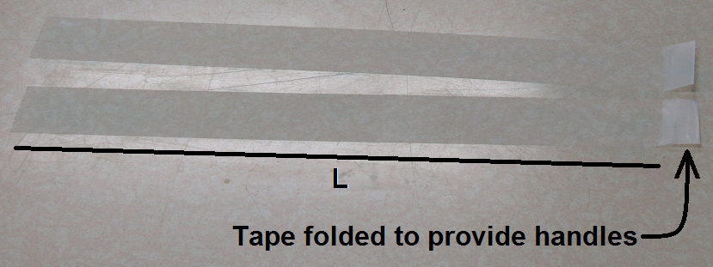
Part I: Coulomb’s Law
Cut two pieces of tape approximately the same size and measure the length.
Place tape sticky side down on the table. Note the folded over portion at the end to allow for easy removal. Rub the tape to build up charge.

Slide 4
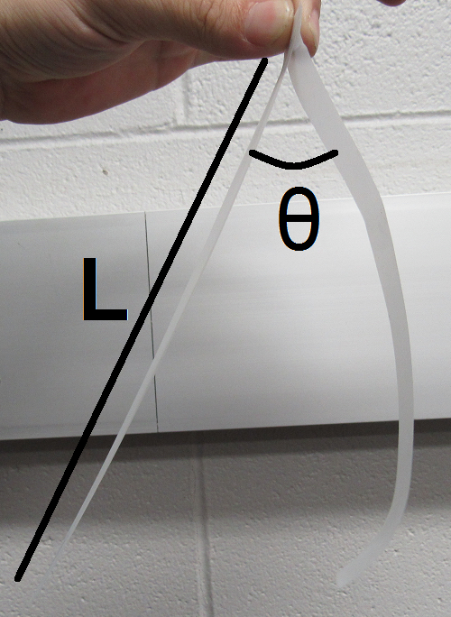
Part I: Coulomb’s Law
Quickly pull the tape off the table and hold the two strips back to back.
The curvature seen in the second strip here is due to a bad pull; ideally both pieces should be straight to simplify measurement of θ.
Beware: In measuring θ, you may find that the tape is attracted to the protractor.
Perform the indicated analysis based on your measured θ and L and the mass given in the report.

Slide 5
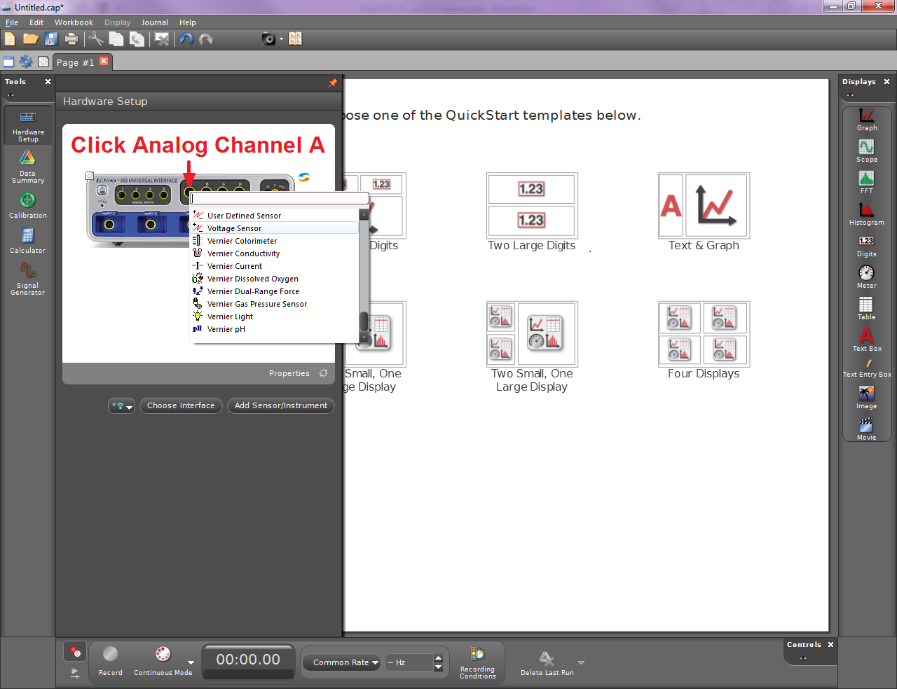
Part II: PASCO Capstone
The pane on the left in Capstone changes based on which tool is selected.
Clicking the currently selected tool hides the pane from view.
Select the Hardware Setup tool and add the Voltage Sensor to the experiment.

Slide 6
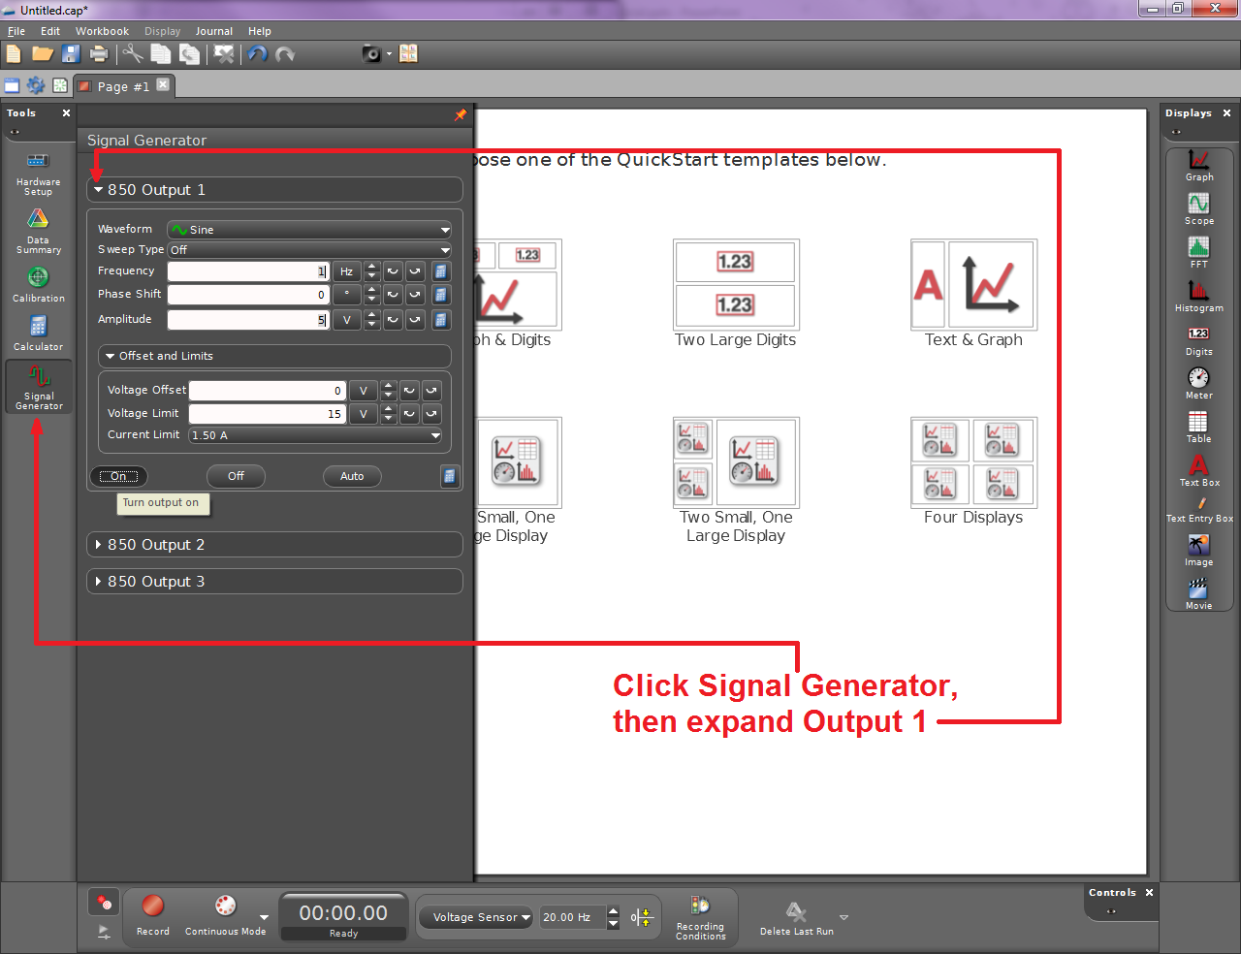
Part II: PASCO Capstone
Select the Signal Generator tool to configure the output signal.

Slide 7
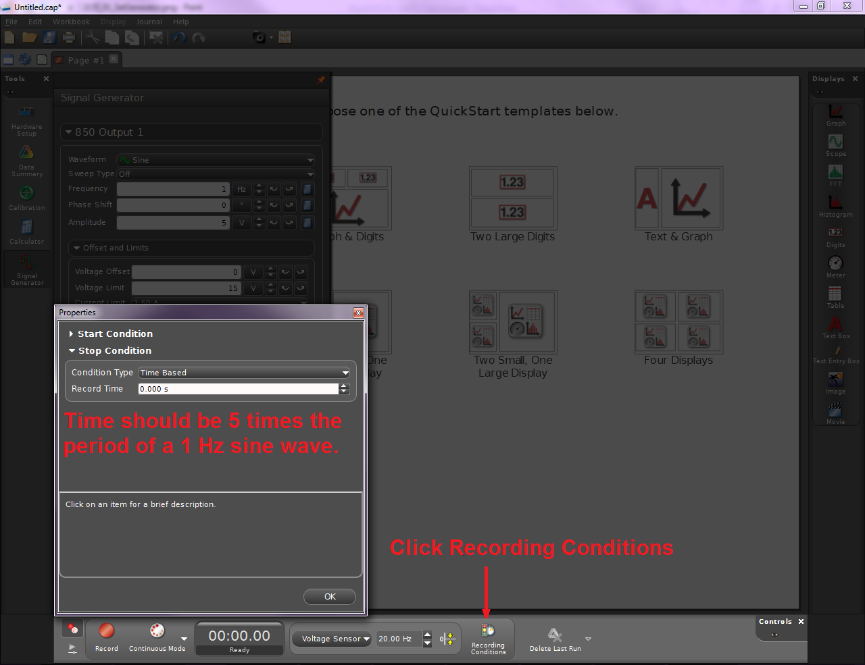
Part II: PASCO Capstone
Set a Stop Condition to automatically end data collection after five cycles have been captured.

Slide 8
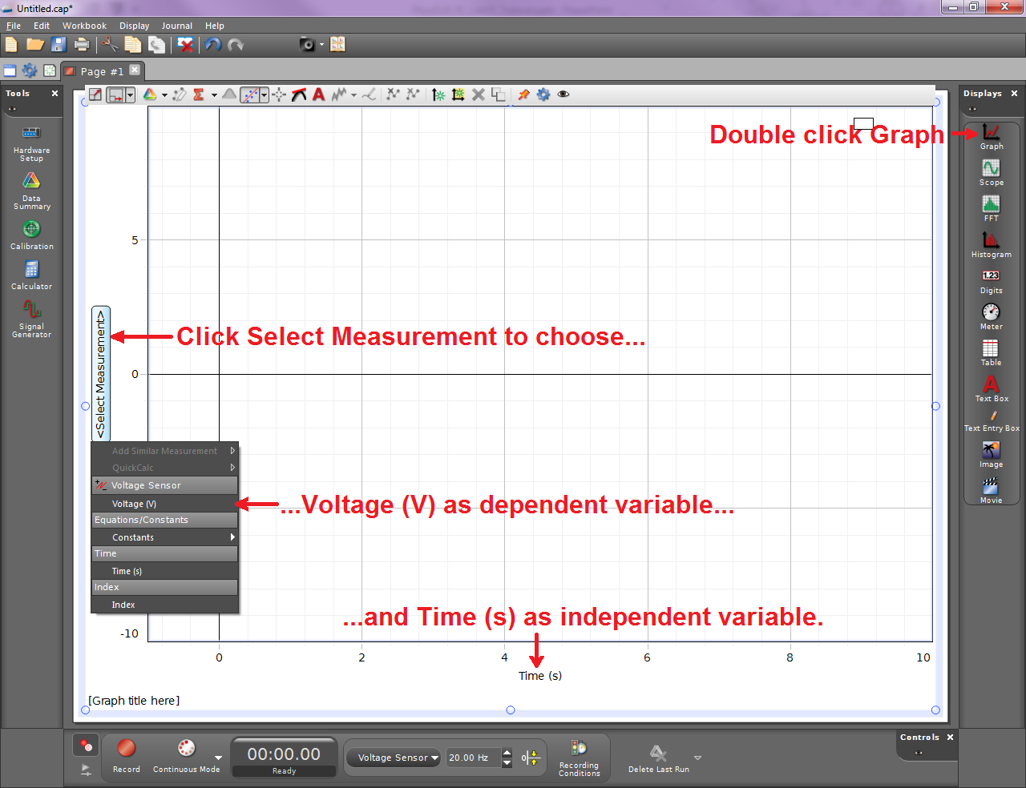
Part II: PASCO Capstone
Hide the left hand pane.
You can choose from several display presets, but today we want a single graph.
Note that you can customize the way data is presented in a given experiment by adding or removing displays.

Slide 9
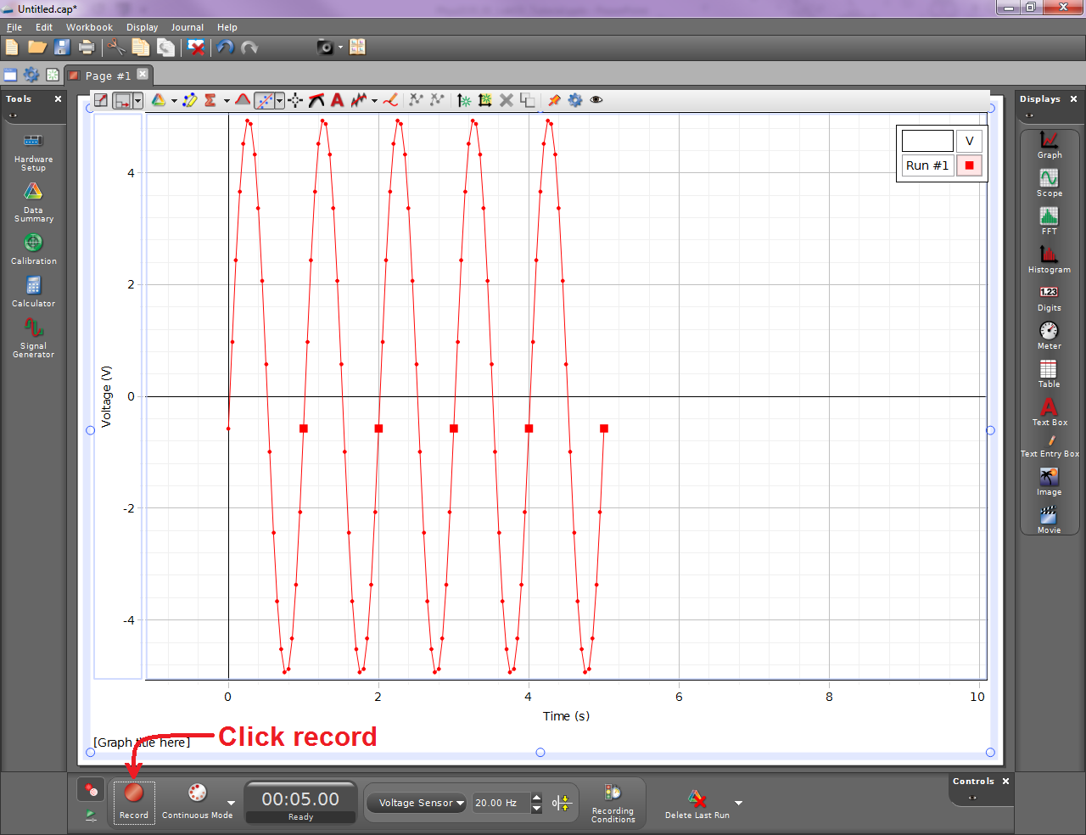
Part II: PASCO Capstone
This is what you should end up with.
If you set your recording condition properly, you won’t have to click Stop; data collection will end automatically.
Don’t forget to write your introduction and conclusion, and add any diagrams indicated in the report.

