Slide 1
Reading Vernier Scales
MS&T Physics 1135 and 2135 Labs

Slide 2
Vernier Scales: Background
Invented in 1631 by Pierre Vernier, Vernier scales allow very accurate measurement of lengths and angles through the use of two scales.
One scale (the primary or data scale) provides the base measurement, with the other (the secondary, indicating, or Vernier scale) increasing precision.
The reading on the Vernier scale is added to the reading on the primary scale to increase the precision. A typical Vernier adds one or two significant figures to a given measurement.
In Physics 1135 and 2135 labs, we use three main devices with Vernier scales: calipers, torsion lathes, and spectrometers. Each is covered in turn in the following slides.

Slide 3
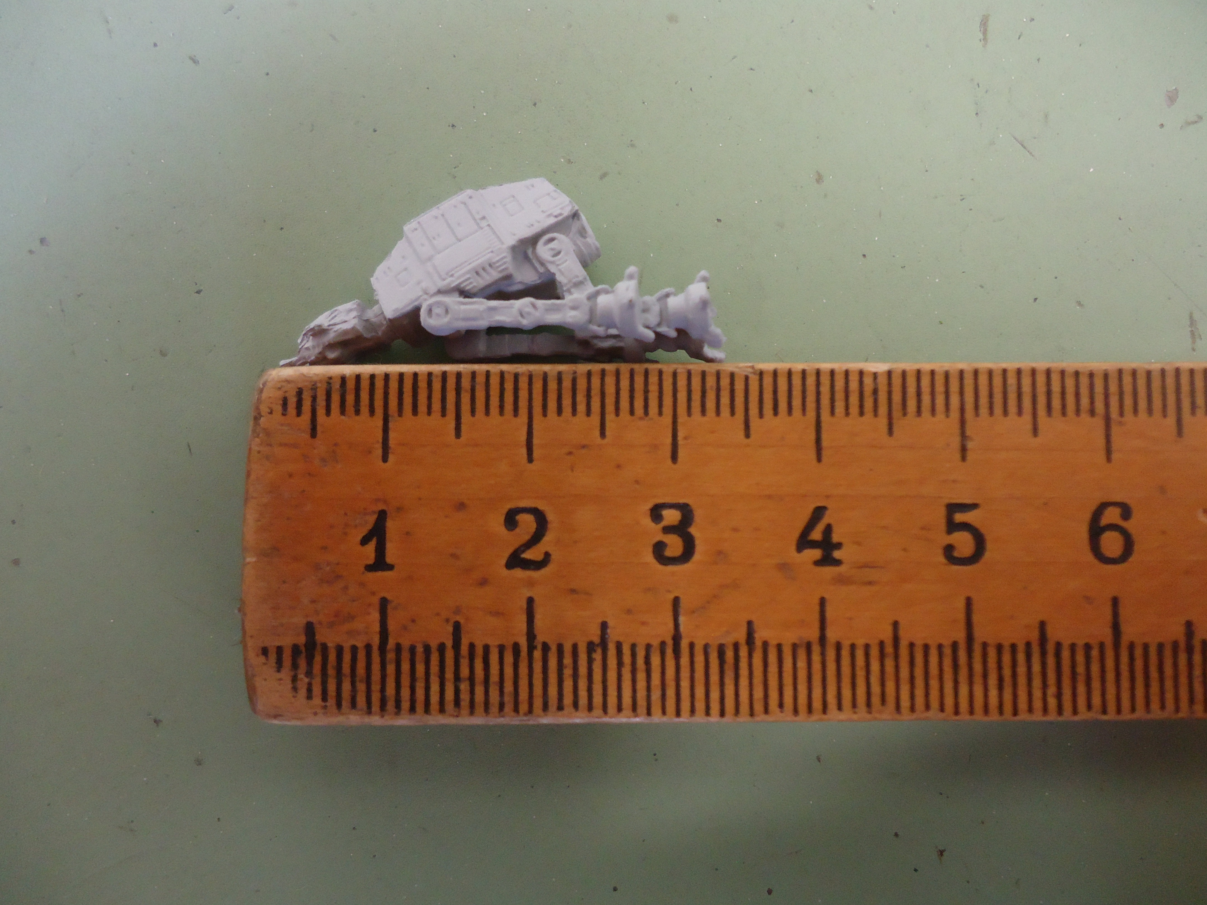
Measurement Basics: the Meterstick
A typical meterstick with divisions spaced 1 mm apart is accurate give or take a millimeter. In this example, x = 33 ± 1 mm
To increase precision, we could add more lines, which would be very difficult to read.
Next, we’ll measure the same object with calipers to see how Vernier scales circumvent this obstacle.

Slide 4
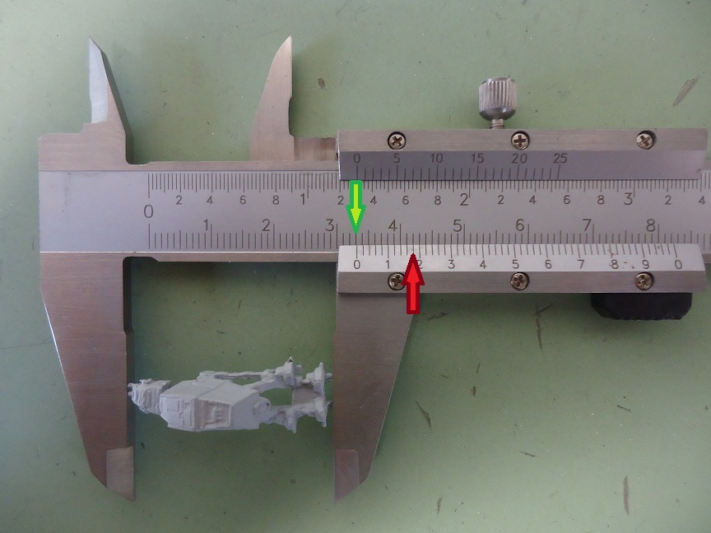
Vernier Calipers
The base measurement is given by the primary marking just left of the zero on the Vernier (green arrow): 3.3 cm, or 33 mm
Next, find the Vernier marking that best aligns with a primary marking (red arrow): the 9th division.
Our measurement is 33 + 9*0.02 mm, or 33.18 mm
This is accurate give or take one division: x = 33.18 ± 0.02 mm

Slide 5
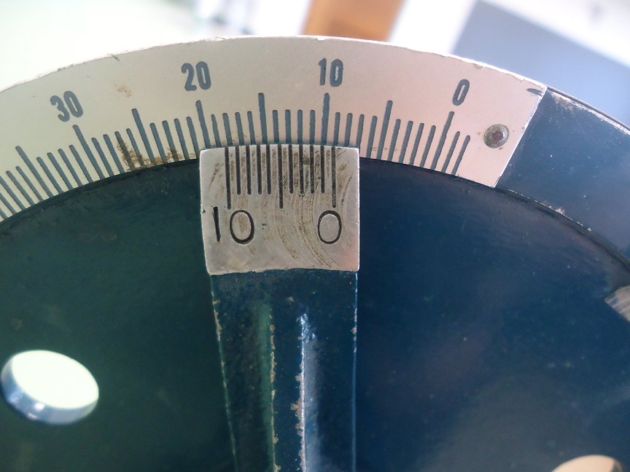
Vernier Scale on a Torsion Lathe
Our torsion lathes use a Vernier to measure angles.
The outer rim is marked in degrees, and there are ten divisions on the Vernier.
Thus, this device is accurate to ±0.1°
The reading shown is 9.2 ± 0.1°

Slide 6
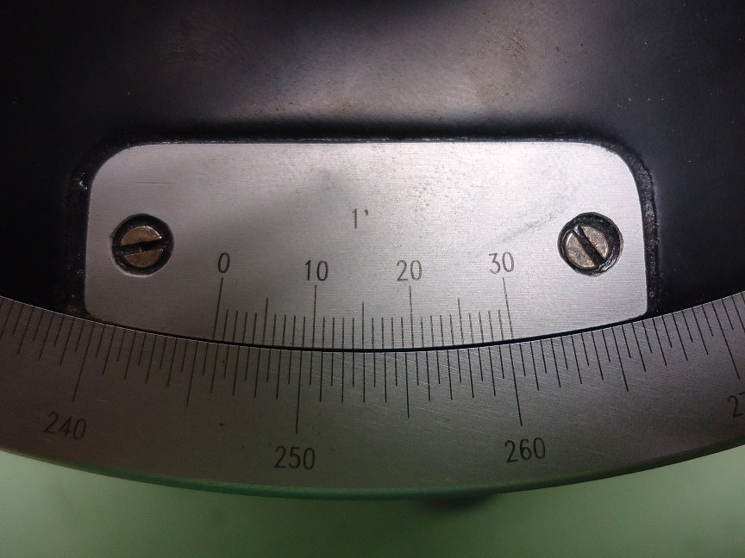
Vernier Scale on a Spectrometer
Our spectrometers also use a Vernier to measure angles.
The outer ring is marked in half-degrees, and there are 30 divisions on the Vernier. This divides 1° into 60 increments, so this device is accurate to ±(1/60)°, or ±1 minute of arc.
The reading shown is 245.5 + 12/60° or 245.7°

