Slide 1
Dispersion
MS&T Physics 2135, Lab E6

Slide 2
Objectives
Use an equilateral triangular prism to determine the refractive index of the prism material as a function of wavelength.
Note: Spectrometers are very expensive and contain many small and delicate pieces. DO NOT ABUSE OUR SPECTROMETERS! Feel free to use the various knobs and screws to align and focus the spectrometer to the best of your ability, but be aware that it’s significantly easier to misalign than it is to align. DO NOT overtighten the screws or try to force something to move past its intended range of motion. If you feel ANY resistance, that means whatever you’re trying to adjust can’t be adjusted any further, so QUIT TRYING!
DO NOT ABUSE OUR SPECTROMETERS!!!!

Slide 3
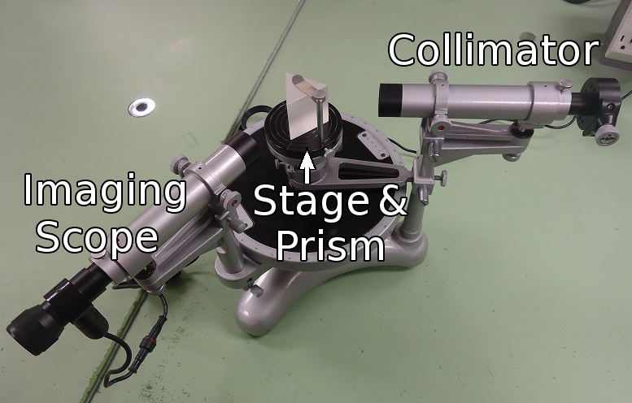
The Spectrometer Explained: Overview
The spectrometer (with the prism in place) is pictured here.
The Collimator makes a narrow beam of light.
This light refracts through the prism and into the Imaging Scope.

Slide 4
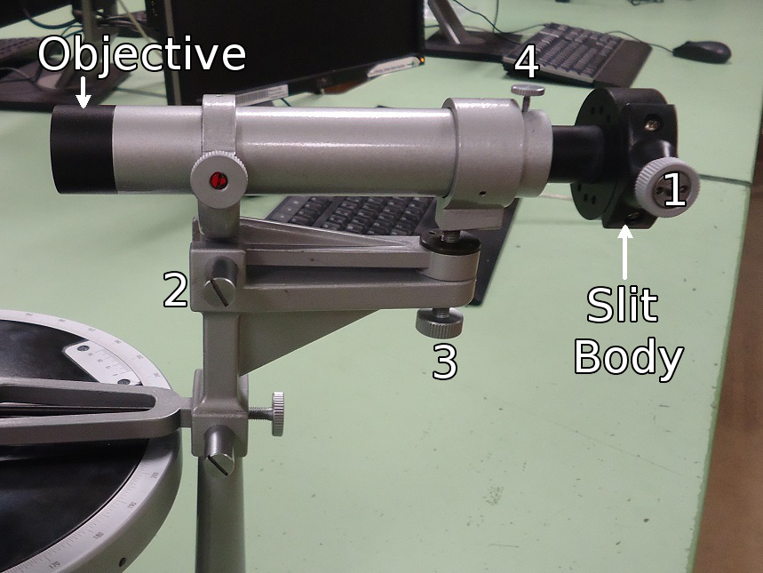
The Spectrometer Explained: Collimator
The slit width can be adjusted with the screw marked 1.
The collimator can be aligned horizontally with screw 2 and vertically with screw 3.
To focus the slit, loosen screw 4 and move the Slit Body in and out of the collimator.

Slide 5
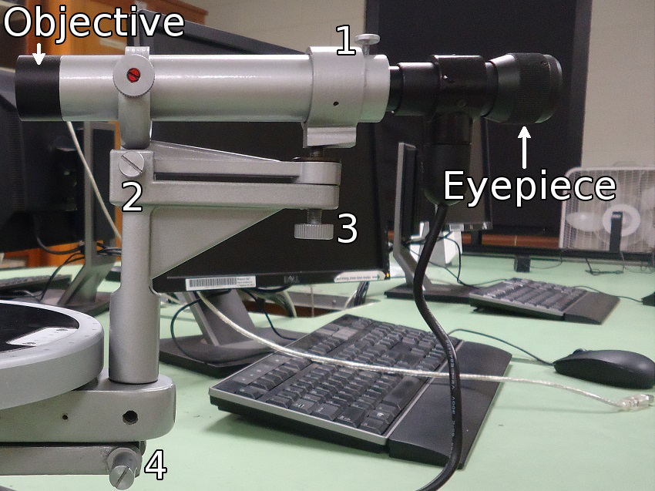
The Spectrometer Explained: Imager
The Imaging Scope can be focused roughly by loosening screw 1 and finely with the knurled rim of the eyepiece.
The scope can be aligned horizontally with screw 2 and vertically with screw 3.
Screw 4 provides fine control of the position of the scope.

Slide 6
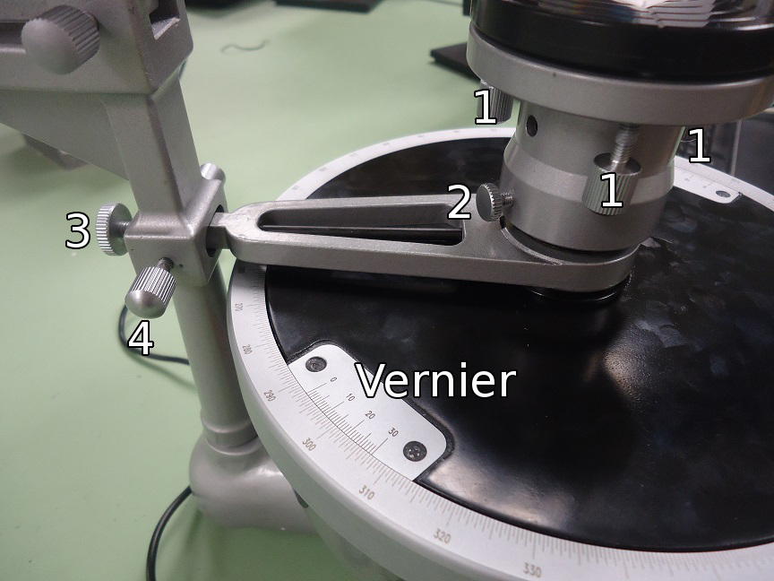
The Spectrometer Explained: Stage
Three screws labeled 1 are used to level the stage.
Loosen screw 2 to raise or lower the stage.
Screw 3 locks the stage to the collimator, and screw 4 provides fine adjust.
The angle is read from the Vernier, marked in minutes of arc (1° = 60 minutes).

Slide 7
Finding Minimum Deviation
Here’s a cartoon of what you should see when you rotate the stage while looking through the imaging scope. Click to start the animation.
The spectrum will move in one direction, then turn around.
If the spectrum does not turn around, rotate the stage in the other direction.
The goal is to lock the stage when the spectrum reaches its turning point.

Slide 8
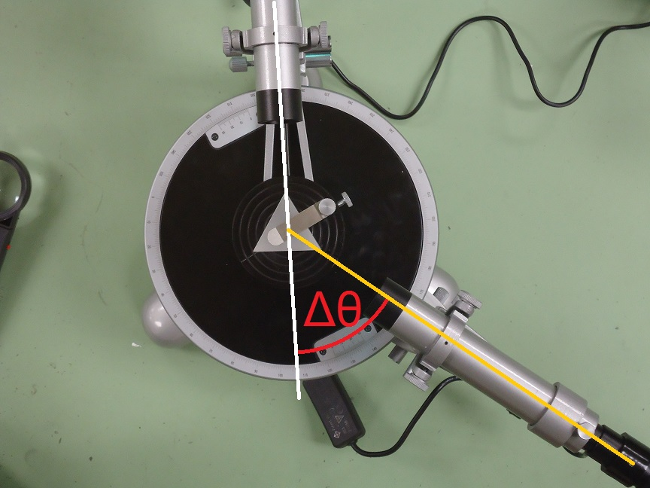
A Note on Angles
The white line represents the straight through position.
The yellow line represents the current position, with the crosshair centered on the yellow doublet.
In calculating n for the yellow lines, we use the difference between the current reading and the straight through as δ_{MIN} in the equation.

