Slide 1
RC Circuits
MS&T Physics 2135, Lab O4

Slide 2
Objectives
Measure the time constant of a series RC circuit.
Determine C
Note: You will be using a 1F, 5V electrolytic capacitor today. Power must always be applied such that the positive terminal (red lead) is at a higher voltage than the negative terminal (black lead). Connecting the capacitor backwards or exceeding 5V may cause irreparable damage, so DON’T DO IT!!!!

Slide 3
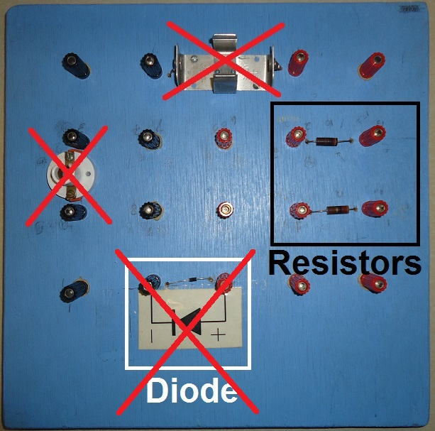
The Blue Board Explained
The two components in the black box are resistors. Measure both with your DMM; they should have similar resistances. Use the smaller one if there is a significant difference.
The other components (diode, bulb socket, and battery clip) are unused in this lab. There are no connections between any of the remaining terminals on the board.

Slide 4
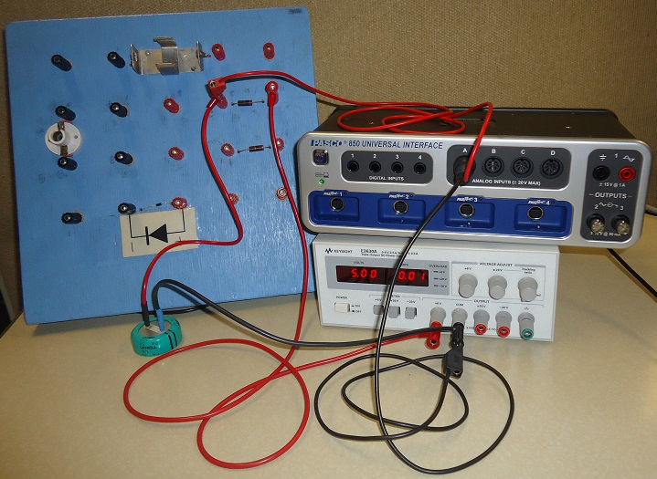
Taking Data
Charging circuit pictured.
The Capstone voltage probe connects directly to the capacitor leads.
Measure and plot V_{C}(t) for both the charging and discharging circuits.
Perform the analysis on the discharging data only.

