Slide 1
Standing Waves
MS&T Physics 1135, Lab E6

Slide 2
Objectives
Observe and characterize standing waves on a string.
Note: The mechanical oscillator consists of a speaker that drives a post up and down. There is a lever at the top of the housing that blocks the path of this rod. DO NOT apply a signal to the oscillator with this lever in place; make sure the rod is able to move freely before you turn on the function generator!

Slide 3
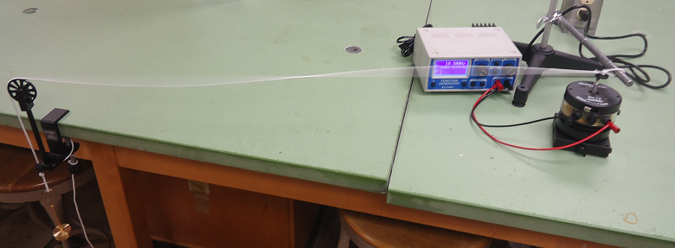
Apparatus
Here, the string is being vibrated at a near-resonant frequency, so there are no stable nodes or antinodes.

Slide 4
Standing Wave: Counting Nodes
Here are two different standing waves, with nodes indicated by red arrows.
As n increases, the frequencies become harder to find.
Here, the string is being vibrated at a near-resonant frequency, so there are no stable nodes or antinodes.

