Slide 1
Oscillatory Motion: the Pendulum
MS&T Physics 1135, Lab O6

Slide 2
Objectives
Determine g, the acceleration due to gravity, using a pendulum.
Determine the dependence of the pendulum’s period T on its length L, and upon the initial angle of the pendulum bob.
Note: Great care must be taken in arranging the pendulum and photogate. The pendulum must swing from a single, consistent point on the hanger such that the length does not vary as the pendulum swings. The pendulum must reliably trigger the photogate without ever colliding with it or the stand. Finally, you must be able to reliably measure the initial angle of the pendulum without affecting the free motion of the pendulum.

Slide 3
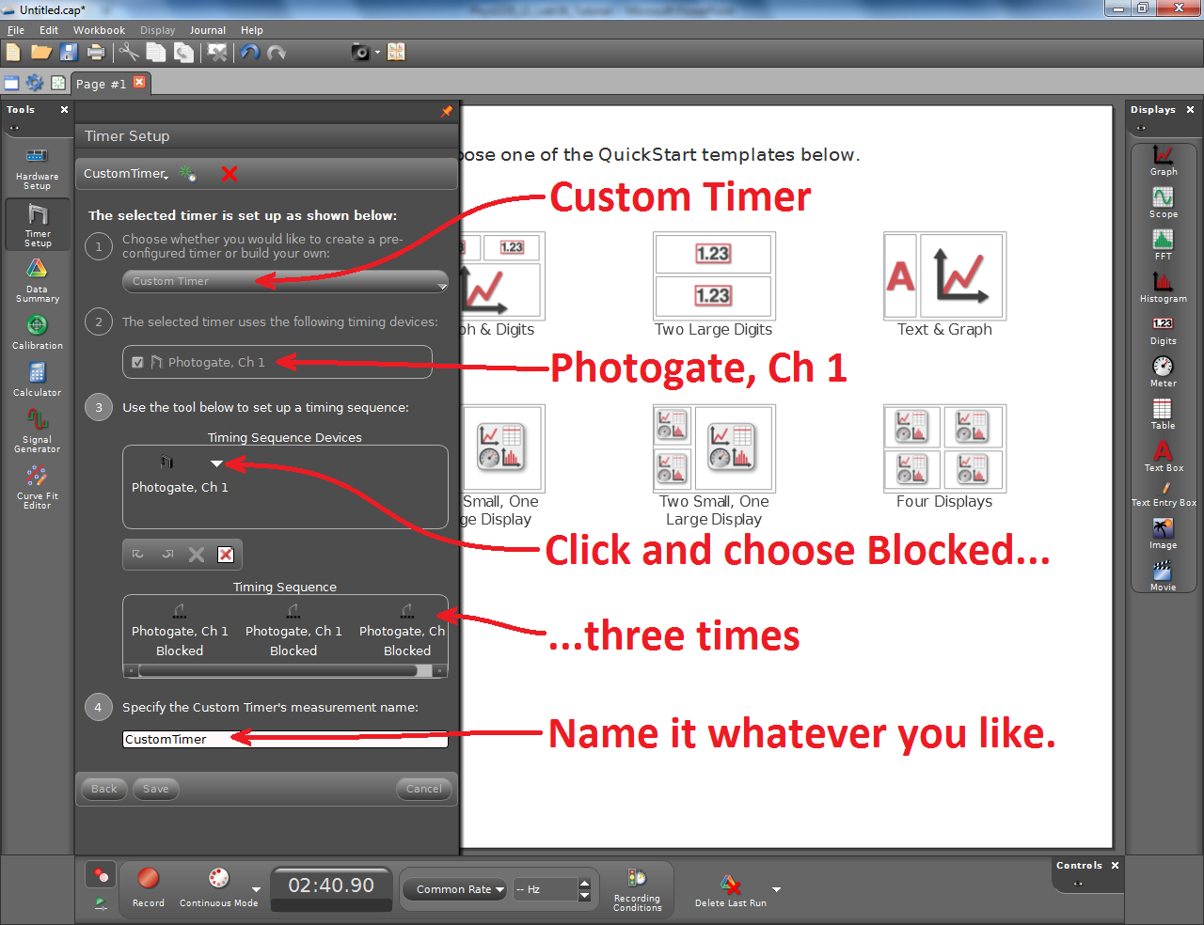
Adding a Timer to Capstone
Add a Photogate in the Hardware Setup tool.
In the Timer Setup tool, you will need to build your own timer.
Once you have your timer configured, create a table and take data as indicated in the lab manual.

