Slide 1
Rotational Collisions
MS&T Physics 1135, Lab E5

Slide 2
Objectives
Use rotational collisions to study the conservation of angular momentum when two or more rotating objects interact.
Note: You will need to level the apparatus to get the best results possible. You will also need to apply force to the smart pulley to keep it in contact with the disk. You should consider how this impacts your measurements and discuss it in your conclusion, along with any other sources of error.

Slide 3
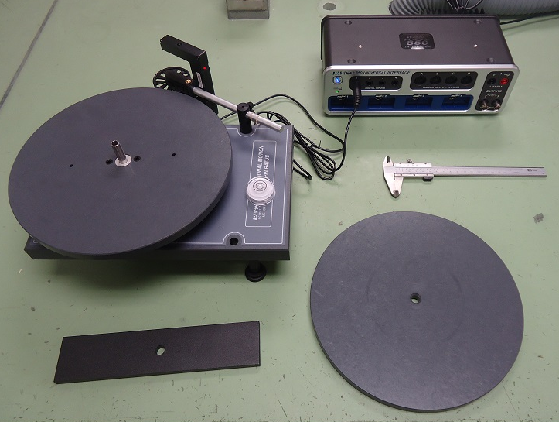
Apparatus
The disk turns the smart pulley such that both have the same linear speed.
When the two rotating bodies collide, the total moment of inertia increases.

Slide 4
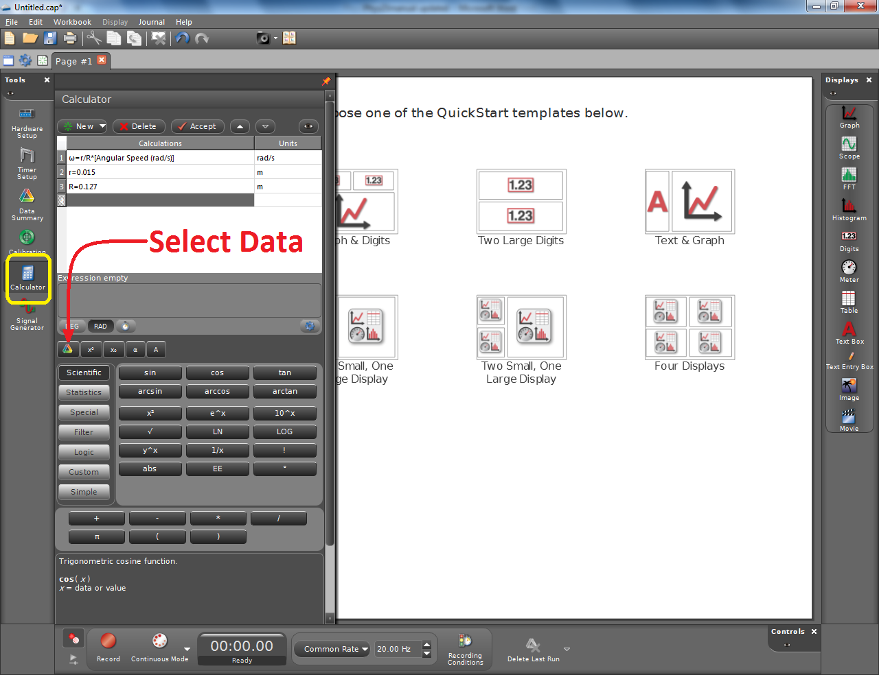
Adding a Calculation to Capstone
Add a Photogate with Pulley in Hardware Setup.
In the Calculator tool, enter and accept the equation to convert the pulley’s speed to the disk’s speed.
You will need to define your radii and use the Select Data button to add the angular speed measurement.

Slide 5
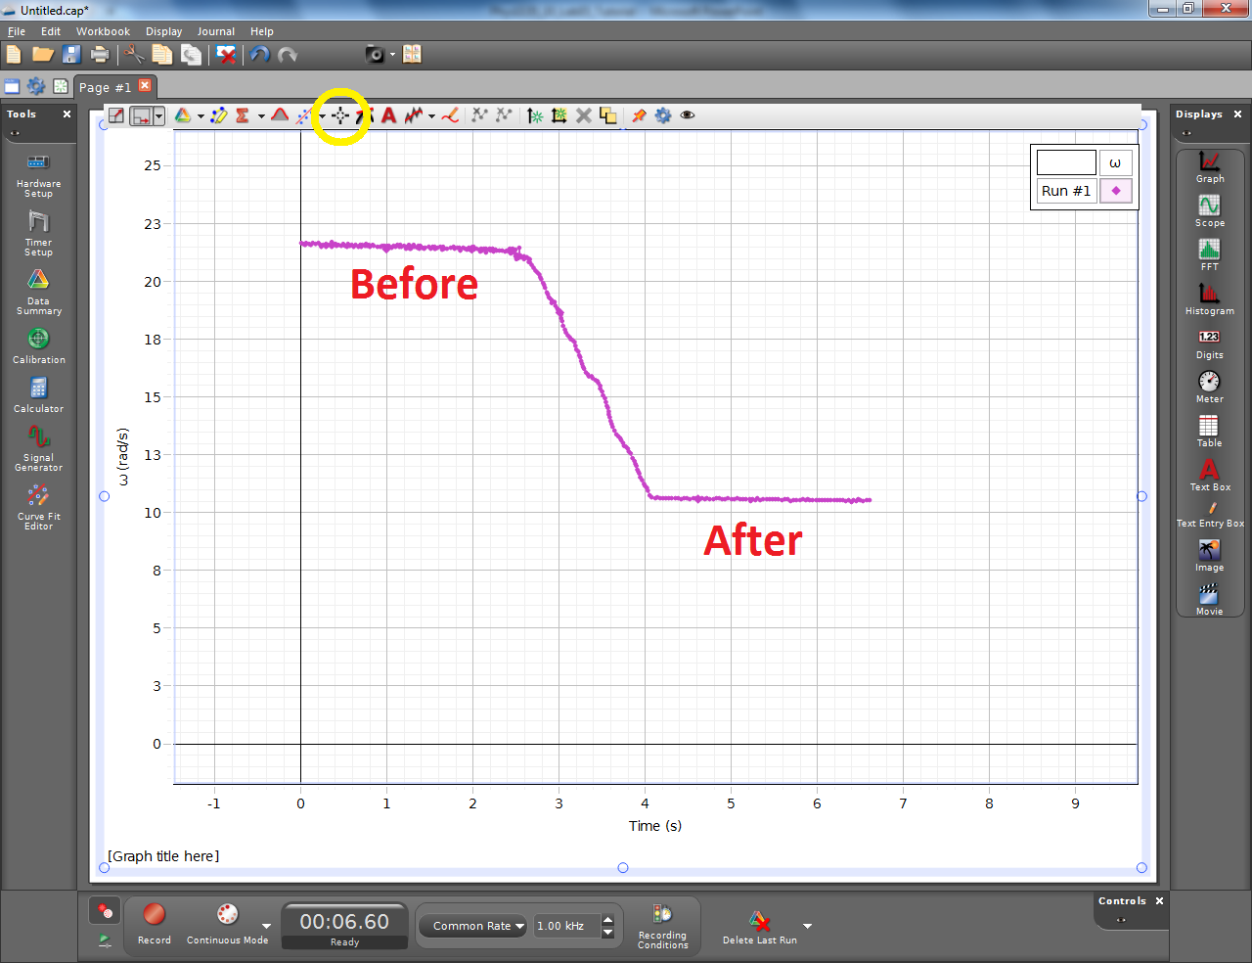
Adding a Plot to Capstone
Plot the angular speed of the disk as a function of time.
You will see a clear difference between the speeds before and after the collision.
You need to determine these two speeds as accurately as possible. The Coordinates tool (yellow circle) may help, or you might choose to use a table instead.

