Slide 1
Rotation with Constant Angular Acceleration
MS&T Physics 1135, Lab O5

Slide 2
Objectives
Determine the moment of inertia I of a disk by measuring the angular acceleration α when a constant torque is applied.
Note: You will need to level the apparatus to get the best results possible. You will also need to apply force to the smart pulley to keep it in contact with the disk. You should consider how this impacts your measurements and discuss it in your conclusion, along with any other sources of error.

Slide 3
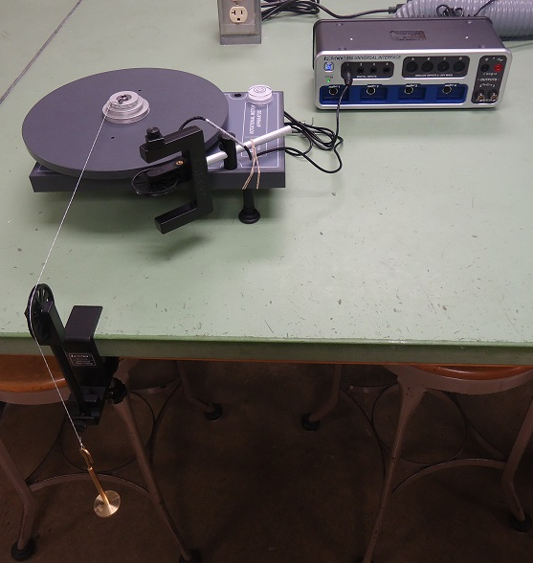
Apparatus
The hanging mass applies torque to the aluminum pulley, turning the disk.
The disk turns the smart pulley such that both have the same linear speed.

Slide 4
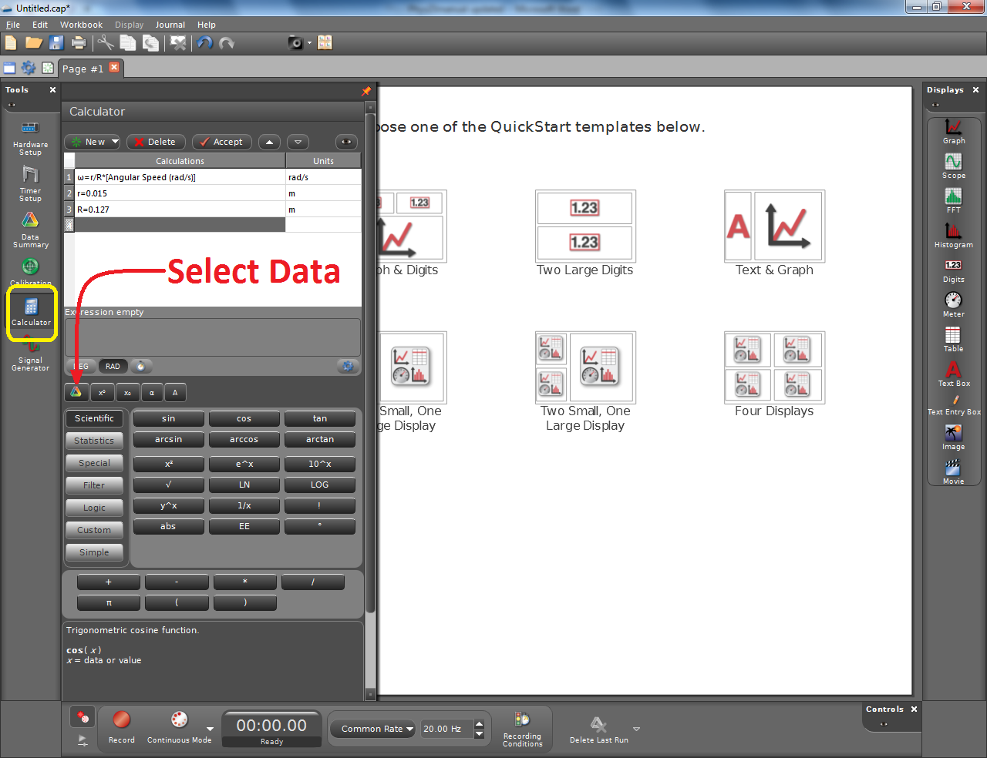
Adding a Calculation to Capstone
Add a Photogate with Pulley in Hardware Setup.
In the Calculator tool, enter and accept the equation to convert the pulley’s speed to the disk’s speed.
You will need to define your radii and use the Select Data button to add the angular speed measurement.

Slide 5
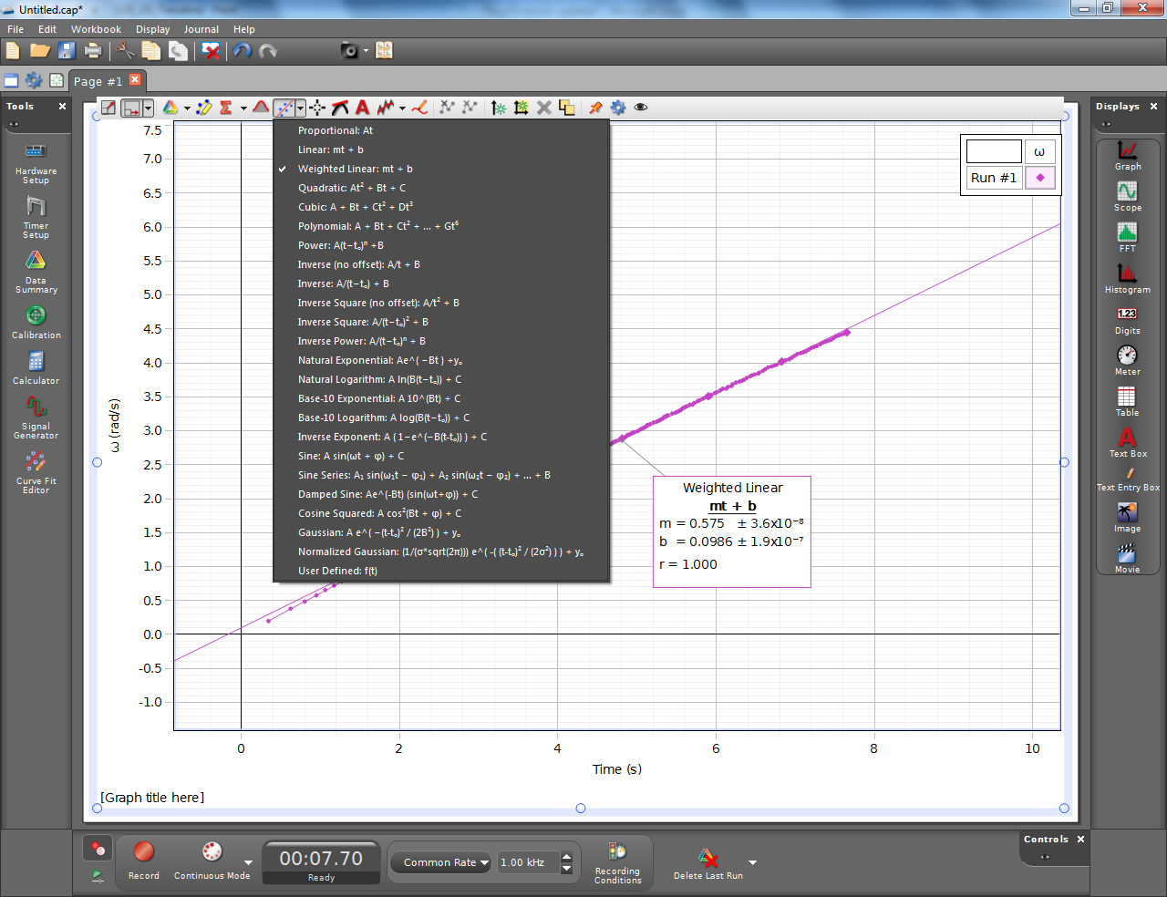
Adding a Trendline in Capstone
Plot the angular speed of the disk as a function of time.
Use the Curve Fit tool to add a Weighted Linear Fit to your data.
If necessary, you can use the Highlighter tool to select data to fit or exclude.
The coefficients and errors will be displayed.

