Slide 1
Archimedes’ Principle
MS&T Physics 1135, Lab E4

Slide 2
Objectives
Determine the density of various solids and liquids using Archimedes’ Principle.
Note: A triple beam balance doesn’t actually measure mass; it measures applied force divided by g, the acceleration due to gravity. Usually, this is the same as measuring mass because the applied force is simply the force due to gravity. In today’s experiment, however, the applied force is the net force pulling down on the submerged object. Thus, the scale reading will be the tension in the string divided by g instead of the mass of the object.

Slide 3
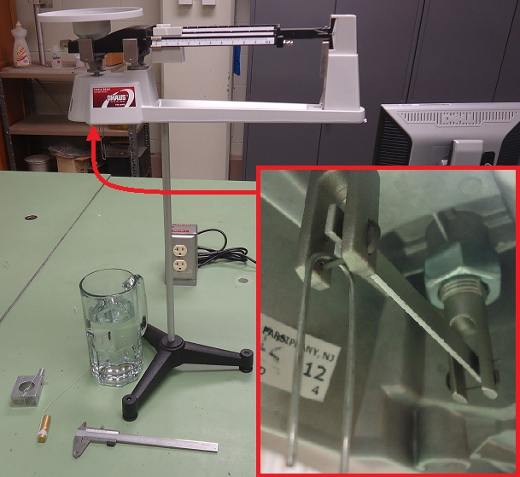
Apparatus
Make sure the object is completely submerged without touching the sides or bottom of the container.
Inset shows how the paperclip should be attached to the scale.
You may need to calibrate your scale before using it.

