Slide 1
Impulse and Collisions
MS&T Physics 1135, Lab O4

Slide 2
Objectives
Measure F(t) vs t during the collision of an air track glider with a force transducer and relate this to Impulse.
Note: Pay attention to the positioning of your bumpers; they must pass through the photogate unimpeded and hit the force sensor squarely. An impact with the photogate or a glancing blow to the sensor will adversely affect your data.

Slide 3
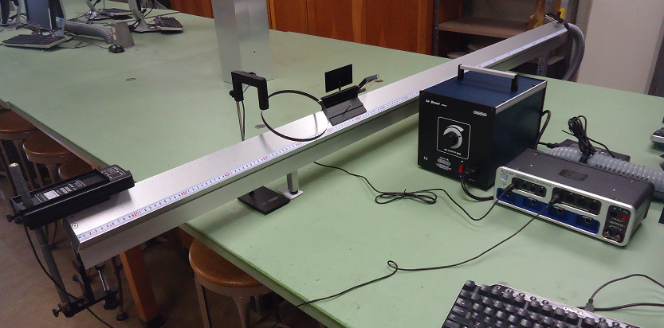
Apparatus
Make sure the bumpers hit the force sensor pad without colliding with the photogate or the force sensor frame or dragging on the air track.
Also make sure the flag triggers the photogate and the bumpers do not.

Slide 4
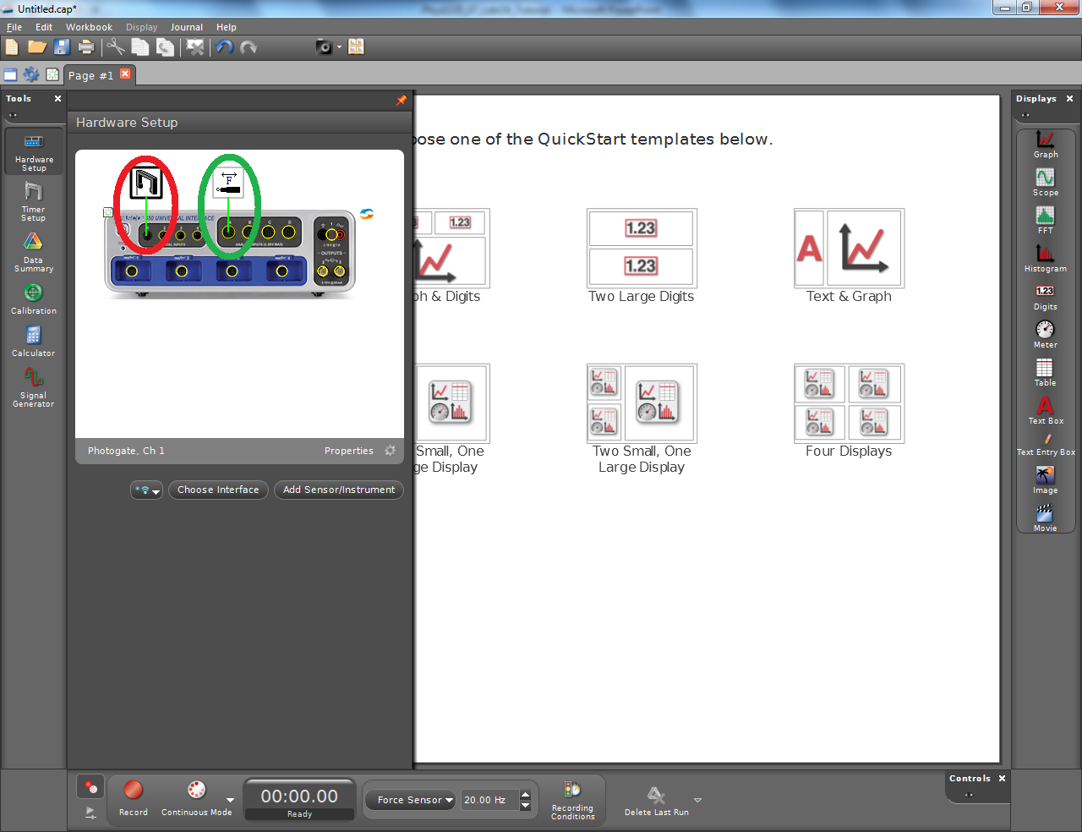
Add Instruments to Capstone
Add a Photogate to Digital Input 1 (red). Configure a timer to measure speed.
Add a Force Sensor to Analog Input A (green).
Press the Tare button on the Force Sensor housing once you have it positioned.
Note: There are 3 types of Force Sensor. Use the first, not the economy or student model.

Slide 5
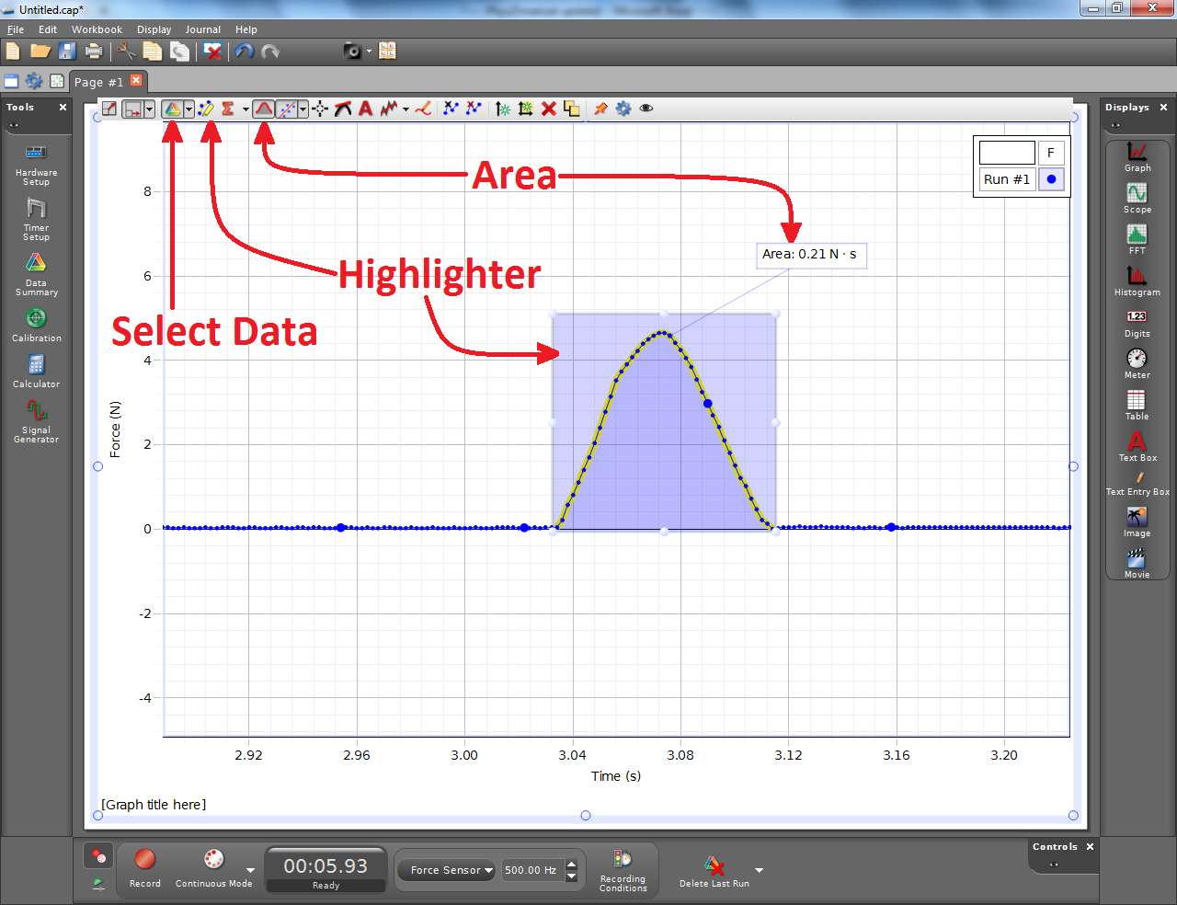
Calculating Areas in Capstone
The Highlighter brings up a box that you can drag to highlight specific data.
The Area tool displays a numerical approximation to the integral of the selected data, or the whole run if no highlighter is active.
These tools can be used independently on each run displayed in the plot.

Slide 6
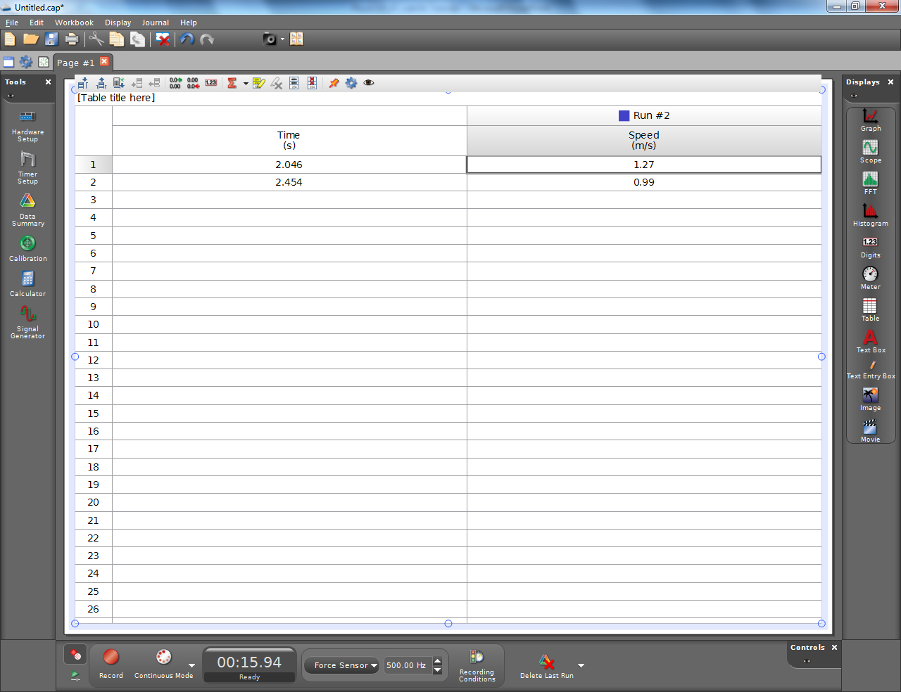
Finding the Impulse in Capstone
Make a table of Time (s) and Speed (m/s) using the data from the photogate.
Capstone has no way to tell which direction the glider is going, so it’s up to you to keep track of which speeds should be positive and which should be negative.

