Slide 1
Conservation of Energy
MS&T Physics 1135, Lab E3

Slide 2
Objectives
Study the relationship between potential and kinetic energy using a modified Atwood’s machine.
Note: You will need to consider which masses to include in your energy calculations. All masses in motion will contribute to the kinetic energy, but not all masses will contribute to the potential energy. Drawing free body diagrams is helpful in this regard.

Slide 3
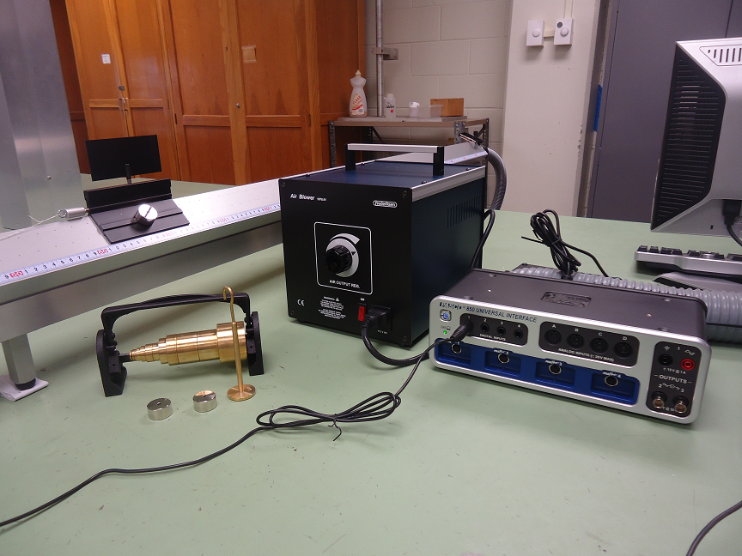
The Apparatus
The brass masses are for the hanger.
The chrome masses are for the glider.
The hook needs to be in the lower hole of the glider.
You will need to know the mass of the glider.

Slide 4
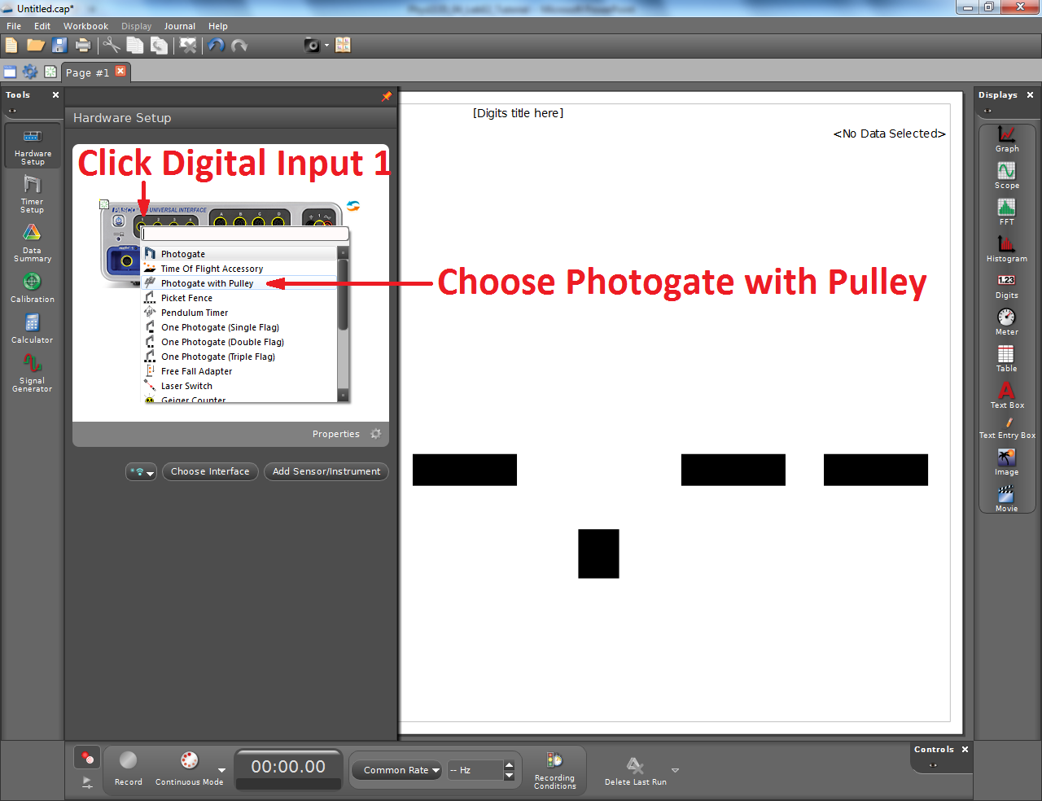
Adding the Smart Pulley to Capstone
Knowing the dimensions and number of spokes of the pulley allows this sensor to provide several measurements based on the time between spokes.
Here, we use it to measure the glider’s position and speed.
The proper dimensions should be entered by default, but they can be changed with the Timer Setup tool if necessary.

Slide 5
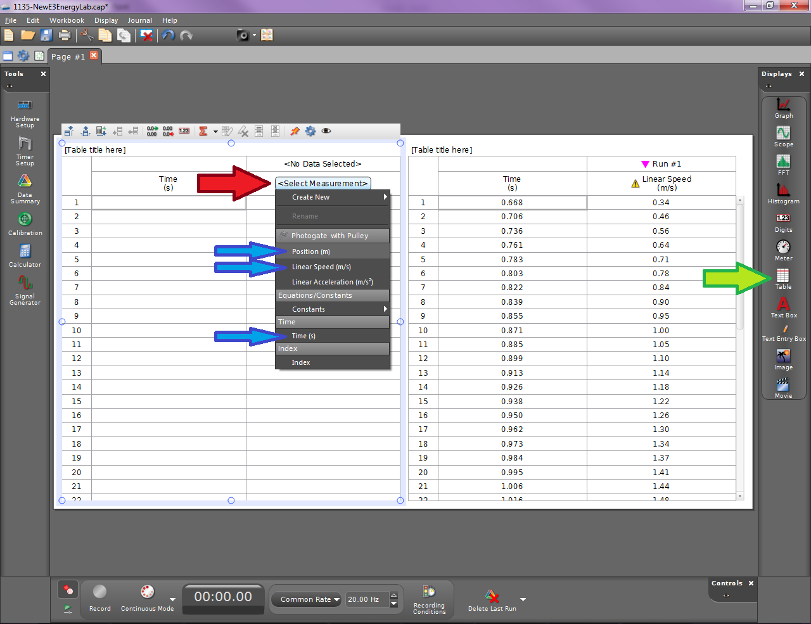
Adding a Table to Capstone
To display your data, make two Table (green arrow).
Click Select Measurement (red arrow) to add data. One table should display Time (s) and Position (m). The other should display Time (s) and Linear Speed (m/s). Their positions in the drop down menu are given by the blue arrows.
You will copy your data into Excel for further analysis.

