Slide 1
Shear Modulus
MS&T Physics 1135, Lab E3

Slide 2
Objectives
Determine the shear modulus of a metal rod.
Note: Some parts of the torsion lathes are fairly easily damaged, so please don’t overtighten the screws or bend the mass hanger lead. Some of the rods are easily bent, so please be careful when handling them. If any equipment is broken when you arrive or breaks while you are using it, notify your lab instructor immediately so that the equipment can be repaired or replaced in a timely manner.

Slide 3
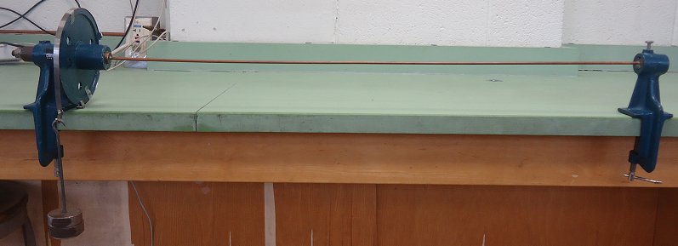
Apparatus
Consult the tutorial on reading Vernier scales for help reading the angles.
The applied torque can be expressed in terms of the hanging mass and lever arm, as well as in terms of the restoring force of the rod (Eq 1 in the manual). This allows experimental calculation of E from measured quantities.

