Slide 1
Coefficient of Friction
MS&T Physics 1135, Lab O3

Slide 2
Objectives
Determine the coefficients of static and kinetic friction for two surfaces.
Determine how these coefficients of friction depend on load.
Note: There are many wrong ways to gather data in this experiment, but only one right way. Make sure that you do it the right way. There are also several different types of force sensor available in Capstone, each with a different operating principle. Make sure you are using the right one. Details follow.

Slide 3
Measuring Force: the RIGHT Way
To zero the sensor before taking data, press the Tare button on the side of the Force Sensor housing with no force applied to the hook.
The pulling force (blue arrow) must be applied completely in the direction of motion (red arrow).
The measured force (green arrow) is the component of force along its long axis.

Slide 4
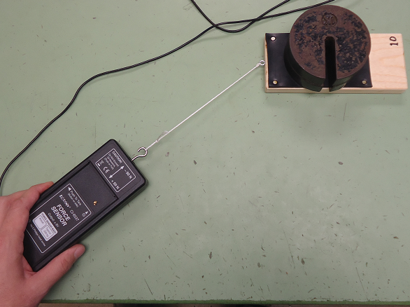
Measuring Force: the WRONG Ways
Here, the applied force is not in the desired direction of motion, so the block will rotate.
This will cause the measured coefficient of static friction to be inaccurate.

Slide 5
Measuring Force: the WRONG Ways
Here, only a portion of the applied force serves to displace the senor.
Top: the rest decreases the normal force.
Bottom: the rest creates an unmeasurable component of force on the hook.
Therefore, neither pull provides accurate data.

Slide 6
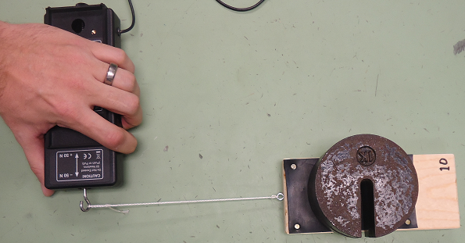
Measuring Force: the WRONG Ways
Here, the applied force is perpendicular to the hook.
Thus, the measured force will be zero, or very close to it.

Slide 7
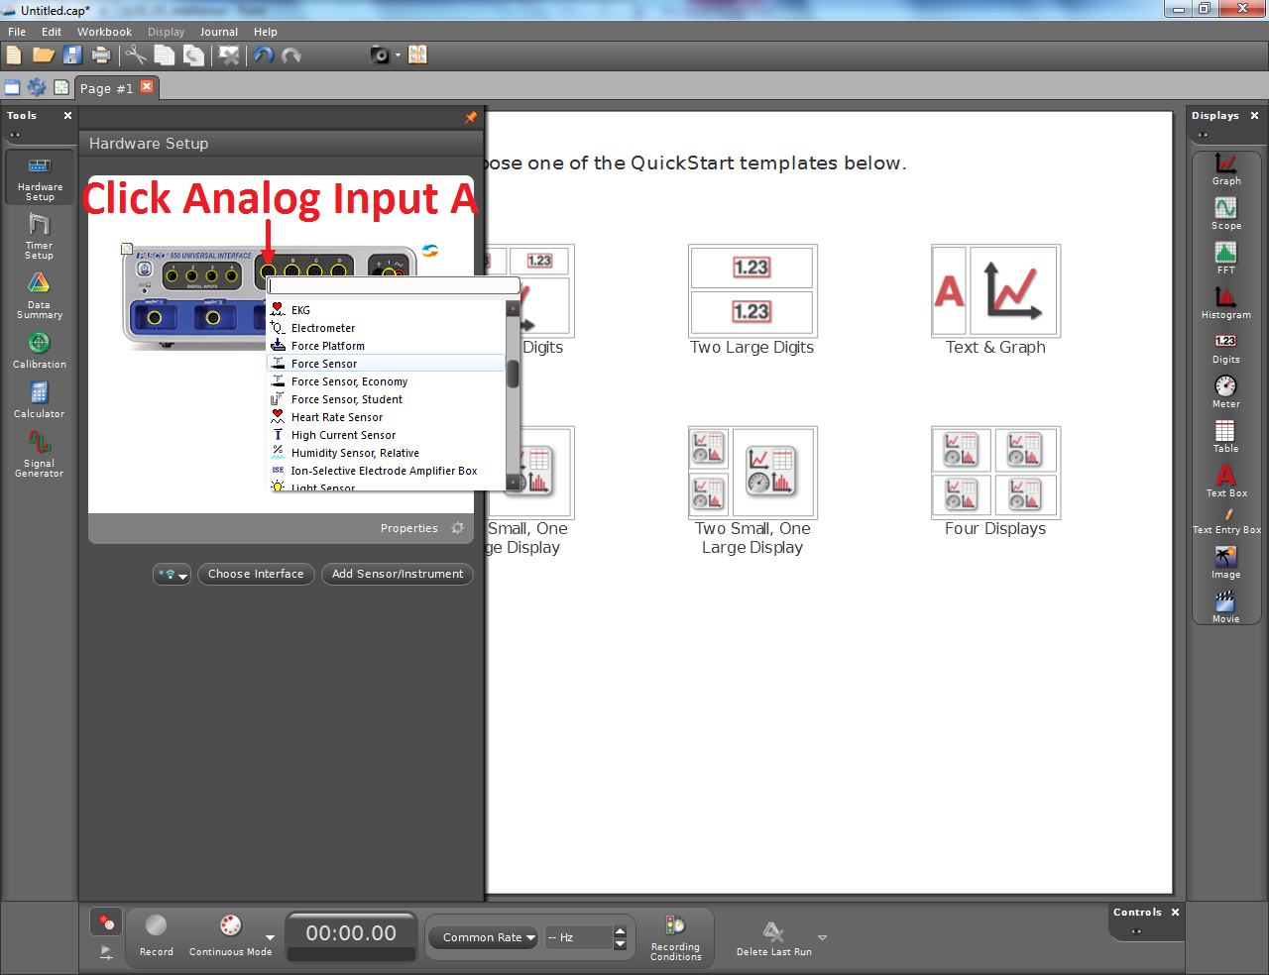
Adding the Force Sensor in Capstone
The pane on the left in Capstone changes based on which tool is selected.
Clicking the currently selected tool hides the pane from view.
Select the Hardware Setup tool and add the Force Sensor to Analog Input A.
Note: Use the first of the three available Force Sensors, not the Economy or Student model.

Slide 8
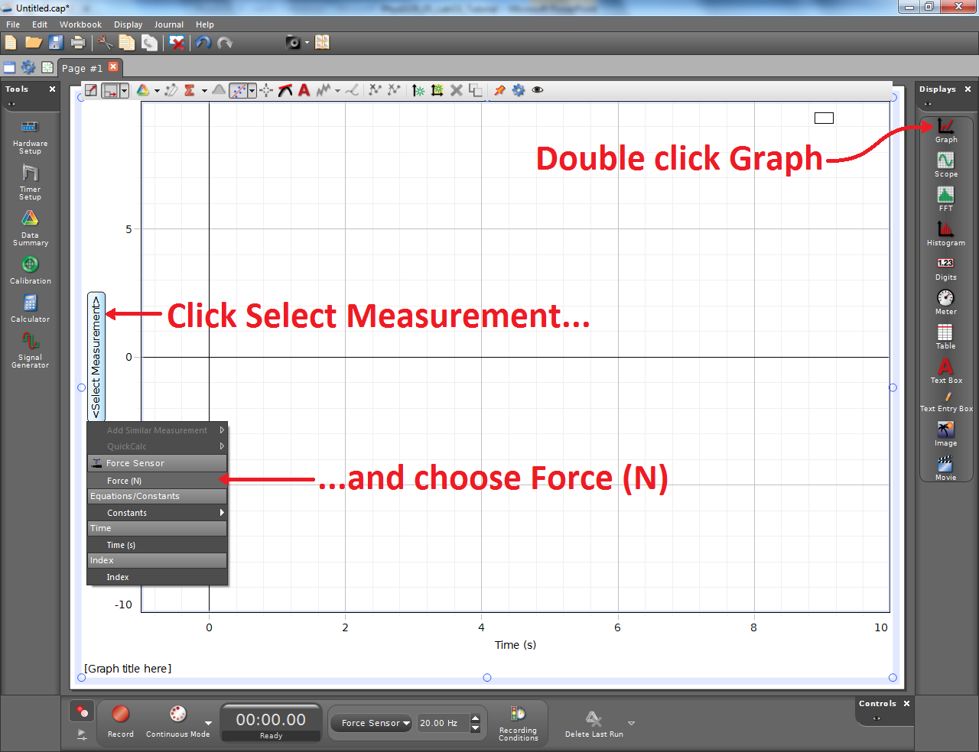
Adding a Plot in Capstone
You can adjust the scale of both axes independently, zoom in or out on either axis or on both simultaneously, and reposition the plot in the window.
Experiment with clicking and dragging in various areas, and using the scroll wheel alone and in conjunction with the shift and control keys.

Slide 9
Good Data
If you pulled the block properly, the plot of F vs t will have a peak followed by a relatively constant region.
The Highlight tool (green arrows) brings up a box you can move and resize to highlight a specific data region.
The Calculate tool (red arrows) can be used to calculate the mean of the highlighted data.
The Coordinates tool (blue arrows) provides a reticle with a readout of the coordinates of the point selected.

Slide 10
Bad Data
You must pull with as constant a force as you can manage to find F_{kinetic}. The data labeled 1 shows why: the part corresponding to kinetic friction is erratic because the applied pulling force was not constant. This data is useless.
If you don’t start your pull gradually enough, you will not have a clear peak. This is shown in the data labeled 2: there is no clear peak, so the force required to overcome static friction cannot be determined. This is also useless.

