Slide 1
Projectile Motion
MS&T Physics 1135, Lab O2

Slide 2
Objectives
Determine the trajectory of a projectile launched by rolling down a ramp.
Note: There are many factors that can affect either the initial velocity of the ball or the accuracy of your measurements of its point of impact and distance traveled. Most can be avoided by keeping the impact board perpendicular to the end of the ramp and ensuring that you release the ball as consistently as possible each time. Others are stochastic and largely unavoidable, but you can minimize them by taking more data and averaging the results. You should discuss as many of these sources of error as possible in your conclusion.

Slide 3
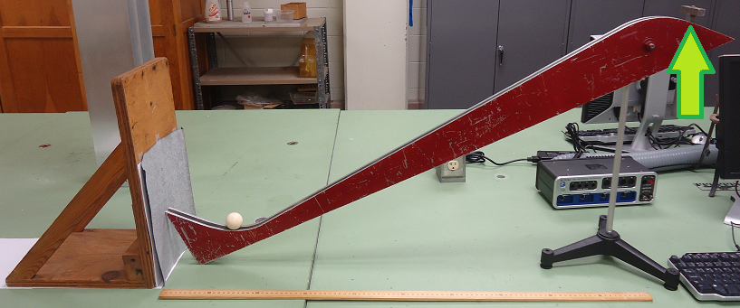
The Apparatus
A sheet of paper is taped to the board, and carbon paper is taped over that.
DO NOT USE the kicker (green arrow); it leads to highly inconsistent releases. Instead, release the ball by hand from the same position each time.

Slide 4
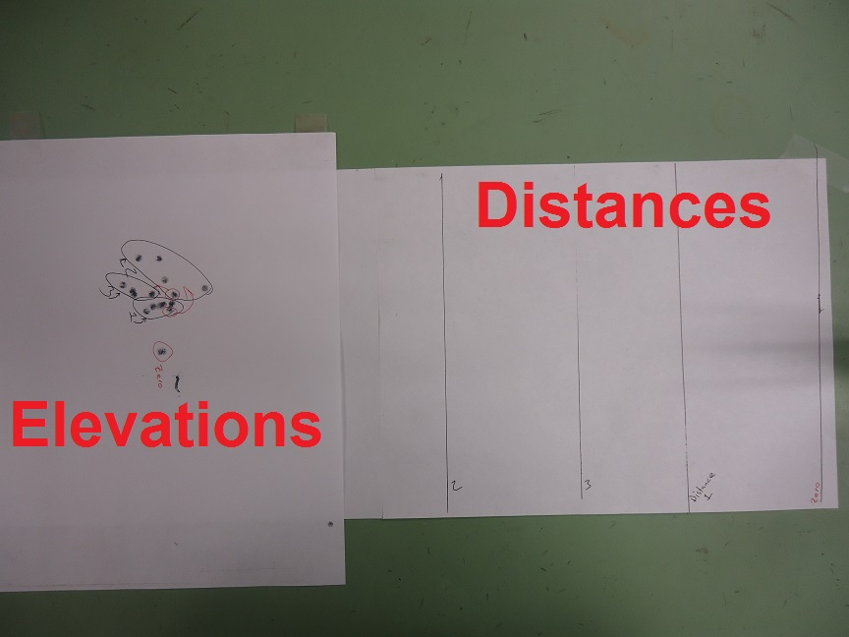
The Results
Marks are shown here for 4 distances, including the zero reference corresponding to the board positioned directly at the end of the ramp.
Five elevation marks were made at each distance, and the distance marks were made by tracing along the bottom of the board at each distance.

Slide 5
Notes on Data Collection
A common strategy is to label each data set by circling it, as shown.
This means a point may end up in the circle of a previous set, as with the red circled points.
Since you must determine both the distance and elevation of every impact, this uncertainty must be avoided!

