Slide 1
Measurement, Errors, and Free Fall
MS&T Physics 1135, Lab E1

Slide 2
Objectives: Part I
Learn to use Vernier calipers.
Learn the precision of measuring instruments.
Review standard deviation.
Review use of Excel and Capstone.
Learn how to determine the error in calculated quantities.
Note: You must provide several sections for each lab report in this class. Details regarding what information belongs in each of these sections can be found in the “General Information” section at the beginning of your lab manual. If you have any questions that are not answered there, consult your lab instructor.

Slide 3
Part I: Measurement and Errors
L
ΔL
ΔD
D
Suppose we have a stick of length L ± ΔL and we cut off a length D ± ΔD.
There are four possibilities for the length of the remaining piece:
$$\left(L+∆L\right)−\left(D+∆D\right)=\left(L−D\right)+\left(∆L−∆D\right)$$
$$\left(L+∆L\right)−\left(D−∆D\right)=\left(L−D\right)+\left(∆L+∆D\right)$$
$$\left(L−∆L\right)−\left(D+∆D\right)=\left(L−D\right)−\left(∆L+∆D\right)$$
$$\left(L−∆L\right)−\left(D−∆D\right)=\left(L−D\right)−\left(∆L−∆D\right)$$
The remaining length, then, lies in the range defined by (L-D) ± (ΔL+ΔD).
The same holds for addition, so errors add over addition and subtraction.
Longest
Shortest

Slide 4
Part I: Measurement and Errors
This process can be applied to multiplication and division as well.
Four possibilities exist for the area of a rectangle of sides a ± Δa and b ± Δb:
$$\left(a+∆a\right)\left(b+∆b\right)=ab+a∆b+b∆a+∆a∆b$$
$$\left(a+∆a\right)\left(b−∆b\right)=ab−a∆b+b∆a−∆a∆b$$
$$\left(a−∆a\right)\left(b+∆b\right)=ab+a∆b−b∆a−∆a∆b$$
$$\left(a−∆a\right)\left(b−∆b\right)=ab−a∆b−b∆a+∆a∆b$$
As shown in the manual, this means the relative errors add when multiplying two quantities with small errors:
$$X=\left(a+∆a\right)×\left(b+∆b\right)\underset{⇒}{}ρ_{X}=ρ_{a}+ρ_{b}$$
From there, we can find the error associated with our measurement of X:
$$∆X=Xρ_{X}=X\left(ρ_{a}+ρ_{b}\right)=X\left(\frac{∆a}{a}+\frac{∆b}{b}\right)$$
The product ΔaΔb is small enough to be negligible

Slide 5
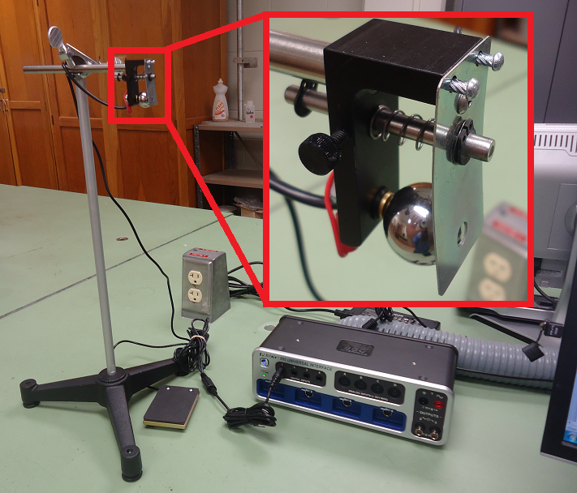
Objectives: Part II
Measure the time it takes an object to fall a distance H and use this to experimentally determine the value of g.

Slide 6
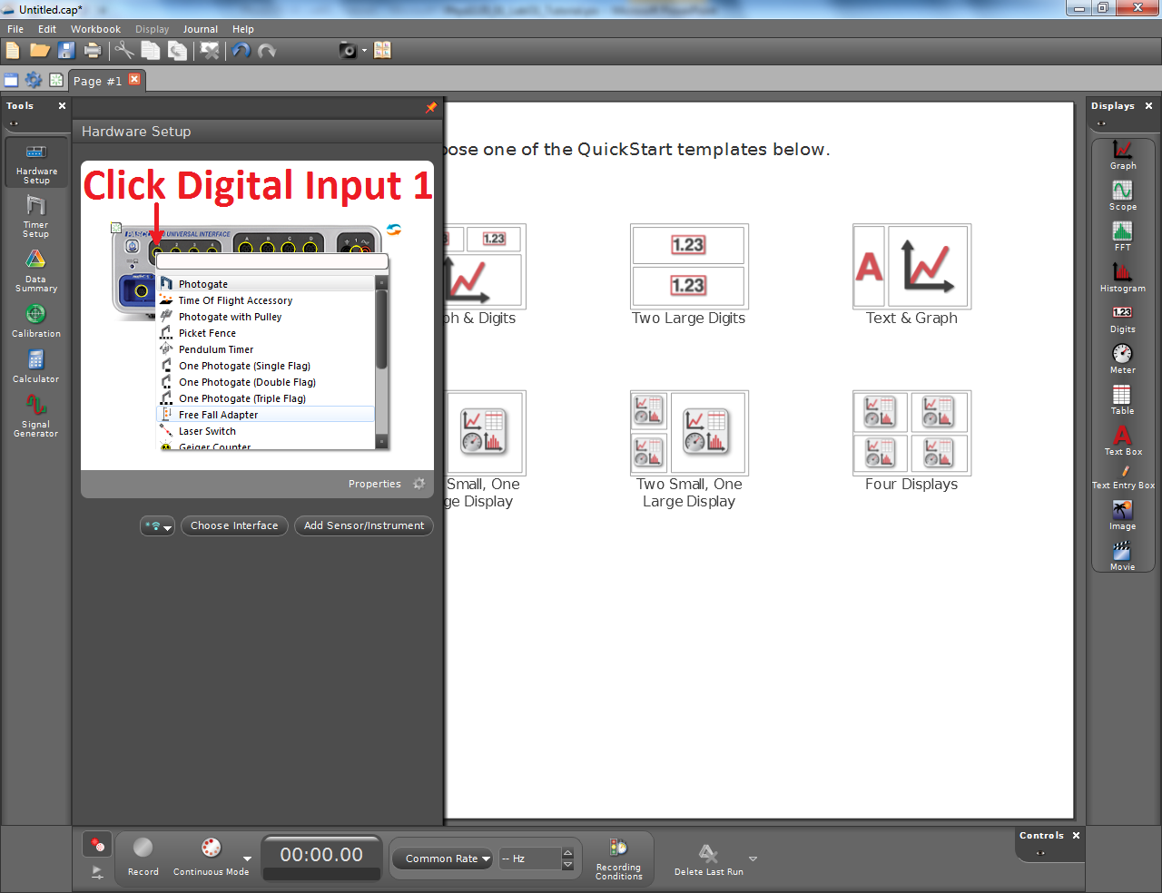
Part II: Free Fall
The pane on the left in Capstone changes based on which tool is selected.
Clicking the currently selected tool hides the pane from view.
Select the Hardware Setup tool and add a Free Fall Adapter to Digital Input 1.

Slide 7
Part II: Free Fall
The steps shown at right will create a digital display for the Time of Fall measurement.
You could use a table as well. The process is similar, but tables in Capstone have two columns by default. We only need one column, so either ignore or delete the other.
Click Record when you are ready to start collecting data.

Slide 8
Notes on Part II
The free fall apparatus is a fairly simple device: the clamp at the top closes the circuit when the steel ball is in place, and the plate at the bottom closes the circuit again when the ball impacts it. The time recorded, then, is the elapsed time that the circuit was open.
This simplicity leads to a tendency to record false data: the device can’t distinguish between the ball impacting the plate and the clamp being closed twice. You must be able to recognize these false readings and discard them!
The lab manual mentions two distinct ways to estimate measurement error. Know which one to use for each measured value, and know how to use those to find the error in any calculated values. You will do this repeatedly in this course, so you would do well to understand it now!

