Slide 1
Measurement, Errors, and PASCO Capstone
MS&T Physics 1135, Lab O1

Slide 2
Objectives
Review Laboratory Report Format
Review Error Analysis
Review use of Excel for analysis and plotting
Learn to use PASCO Capstone, our data acquisition and analysis software
Note: You must provide several sections for each lab report in this class. Details regarding what information belongs in each of these sections can be found in the “General Information” section at the beginning of your lab manual. If you have any questions that are not answered there, consult your lab instructor.

Slide 3
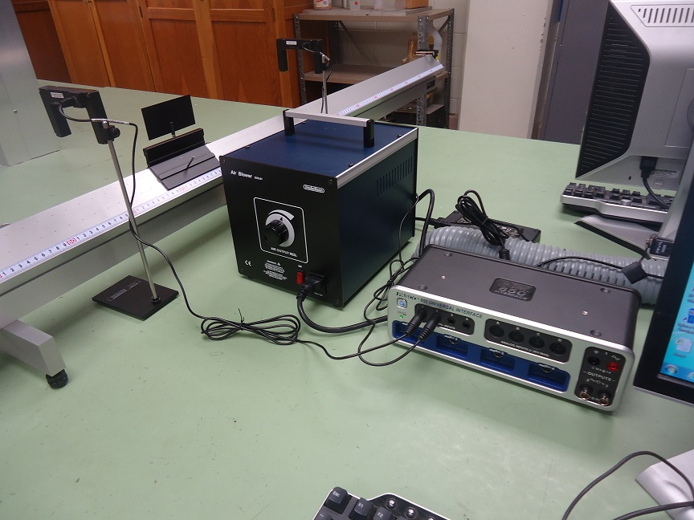
Part I: PASCO Capstone
We will use two photogates to measure the time taken for the glider to travel the known distance between them.
This will allow us to calculate the average speed of the glider.

Slide 4
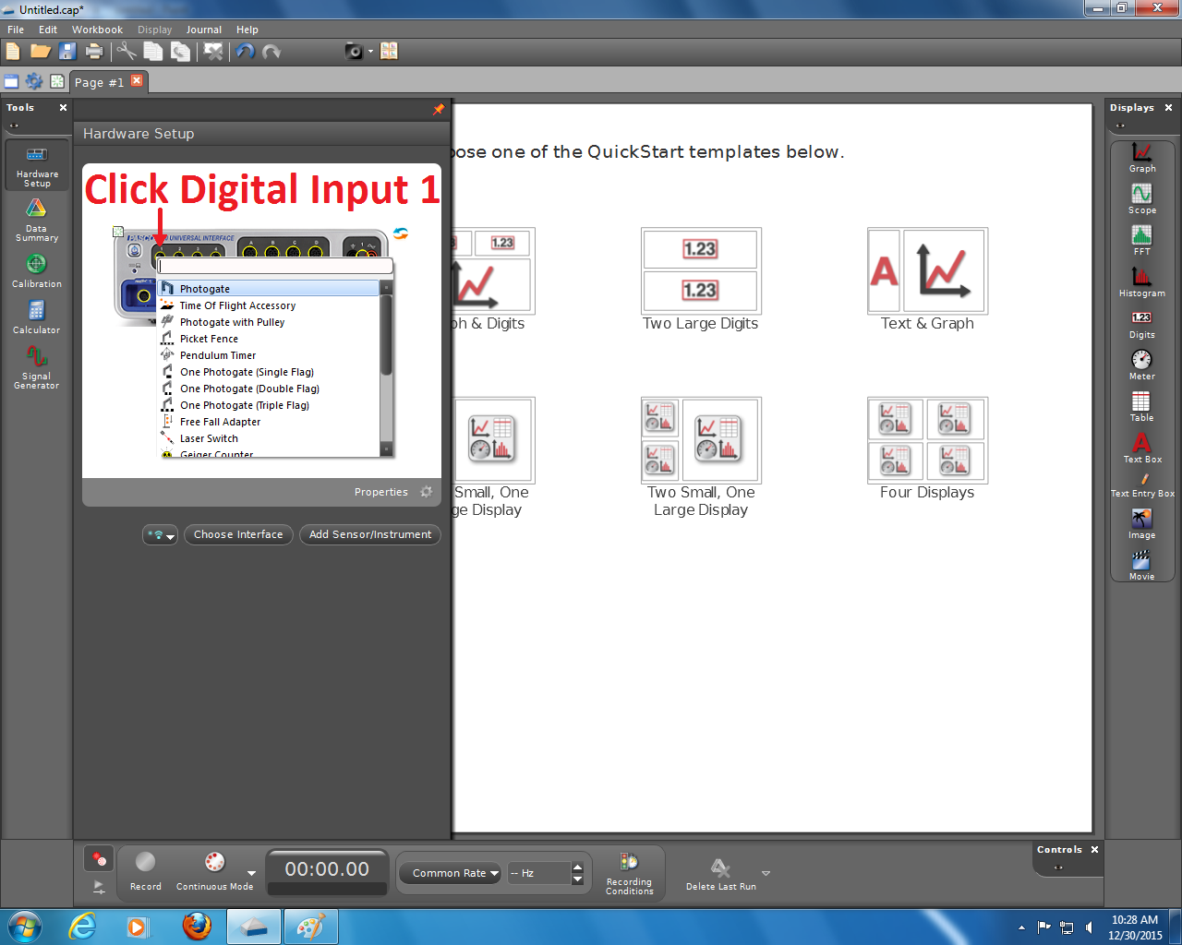
Part I: PASCO Capstone
The pane on the left in Capstone changes based on which tool is selected.
Clicking the currently selected tool hides the pane from view.
Select the Hardware Setup tool and add a Photogate to Digital Input 1.
Add a second Photogate to Digital Input 2.

Slide 5
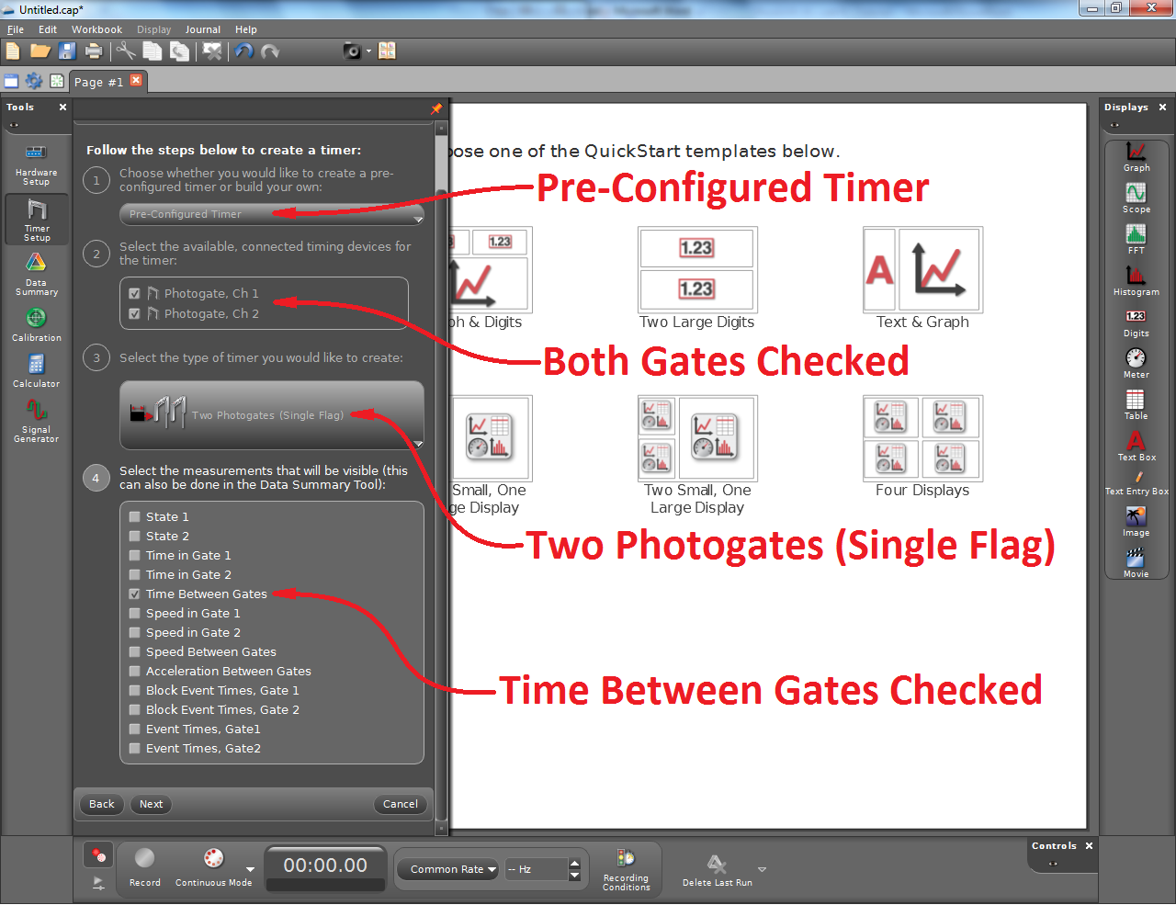
Part I: PASCO Capstone
We want to measure the elapsed time between photogate 1 being blocked and photogate 2 being blocked. This timer does just that.
Steps 1-4 are shown at right.
Step 5 asks for parameters that are not used in this timer.
Step 6 asks you to name the timer. The default name is fine.

Slide 6
Part I: PASCO Capstone
To get measurements from your timer, you will need a display.
The steps shown at right will create a digital display.
You could use a table as well, but be aware that the timer has no way to know which direction the glider is moving, so you may get false data if you let the glider bounce back and forth.

Slide 7
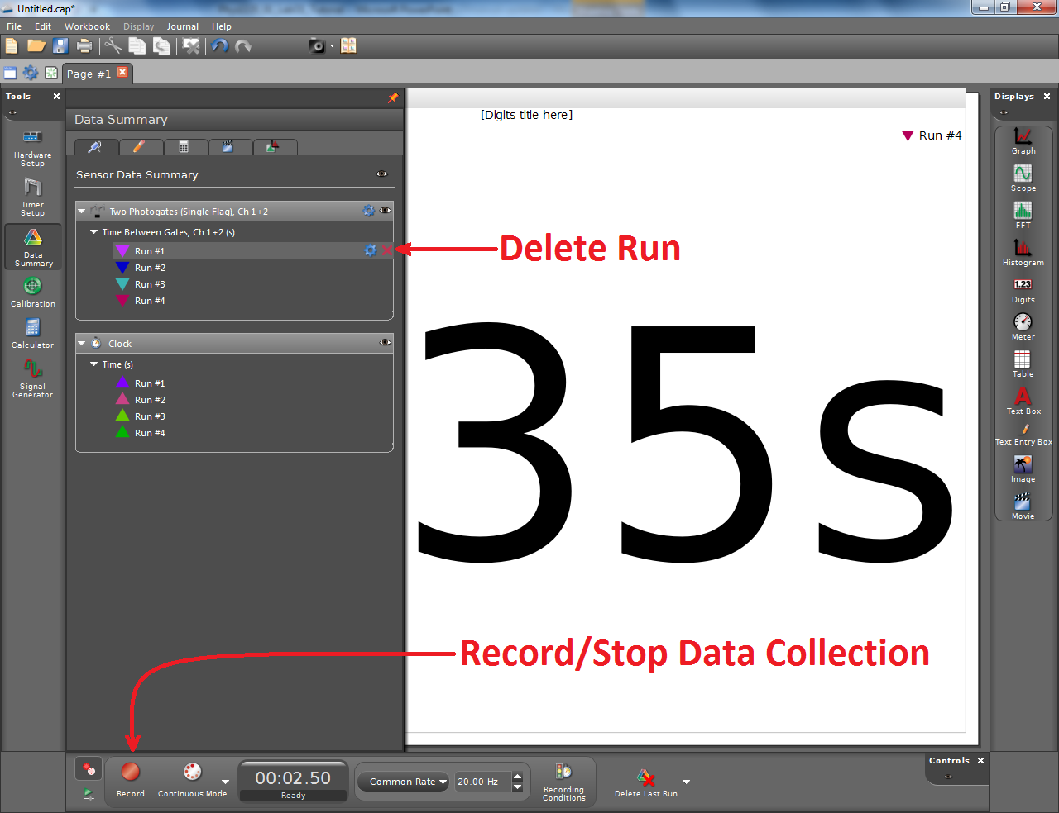
Part I: PASCO Capstone
The timer does not reset if the glider goes through gate 1 twice before going through gate 2, so it’s best to record data one run at a time.
Click Record, push the glider, and click Stop after it passes through both gates.
If you end up with data you don’t need, it can be deleted with the Data Summary tool.

Slide 8
Part II: Measurements and Errors
L
ΔL
ΔD
D
Suppose we have a stick of length L ± ΔL and we cut off a length D ± ΔD.
There are four possibilities for the length of the remaining piece:
$$\left(L+∆L\right)−\left(D+∆D\right)=\left(L−D\right)+\left(∆L−∆D\right)$$
$$\left(L+∆L\right)−\left(D−∆D\right)=\left(L−D\right)+\left(∆L+∆D\right)$$
$$\left(L−∆L\right)−\left(D+∆D\right)=\left(L−D\right)−\left(∆L+∆D\right)$$
$$\left(L−∆L\right)−\left(D−∆D\right)=\left(L−D\right)−\left(∆L−∆D\right)$$
The remaining length, then, lies in the range defined by (L-D) ± (ΔL+ΔD).
The same holds for addition, so errors add over addition and subtraction.
Longest
Shortest

Slide 9
Part II: Measurements and Errors
This process can be applied to multiplication and division as well.
Four possibilities exist for the area of a rectangle of sides a ± Δa and b ± Δb:
$$\left(a+∆a\right)\left(b+∆b\right)=ab+a∆b+b∆a+∆a∆b$$
$$\left(a+∆a\right)\left(b−∆b\right)=ab−a∆b+b∆a−∆a∆b$$
$$\left(a−∆a\right)\left(b+∆b\right)=ab+a∆b−b∆a−∆a∆b$$
$$\left(a−∆a\right)\left(b−∆b\right)=ab−a∆b−b∆a+∆a∆b$$
As shown in the manual, this means the relative errors add when multiplying two quantities with small errors:
$$X=\left(a+∆a\right)×\left(b+∆b\right)\underset{⇒}{}ρ_{X}=ρ_{a}+ρ_{b}$$
From there, we can find the error associated with our measurement of X:
$$∆X=Xρ_{X}=X\left(ρ_{a}+ρ_{b}\right)=X\left(\frac{∆a}{a}+\frac{∆b}{b}\right)$$
The product ΔaΔb is small enough to be negligible

