Slide 1
Navigating Excel

Slide 2
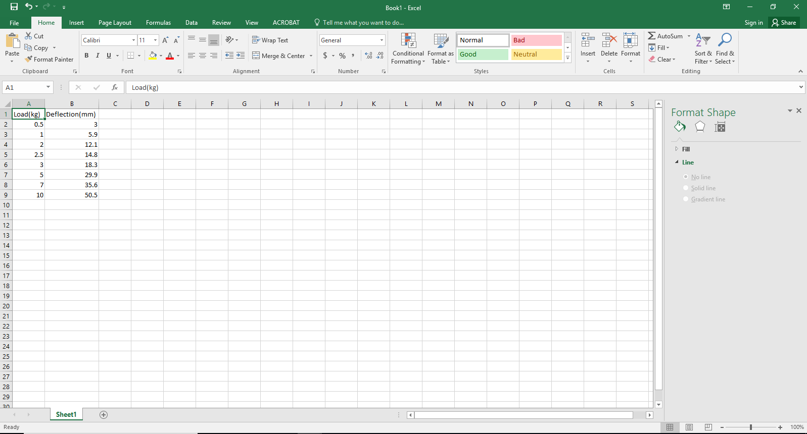
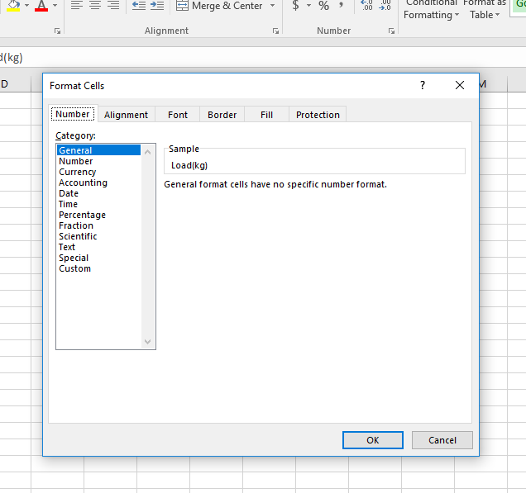
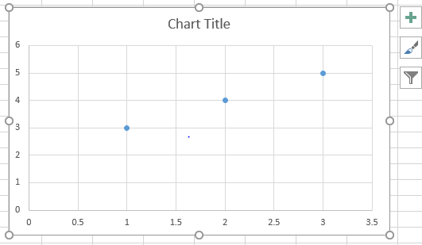
This is the data entry window.
This sidebar menu also has tabs which will change the available options displayed in the sidebar.
This is your standard menu bar.
Once you create a plot, it will appear in the data entry window like this.
Clicking any of the options will change the toolbar below.
If you are unsure how to do something, try browsing through the toolbars, right clicking things with the mouse, or ask a neighboring group.
Clicking on the little arrows in the bottom corners of the toolbar sections will open up an expanded list of options related to that toolbar category.
Selecting something on the plot (by double clicking or sometimes single clicking) will bring up this sidebar with more options.
2

Slide 3
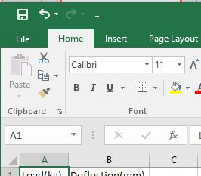
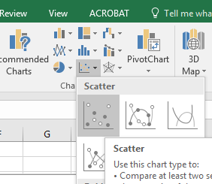
Making a Plot: Part 1
Click the “Insert” Tab
Click where shown to bring up the drop down menu and select the top left picture, “Scatter”.

Slide 4
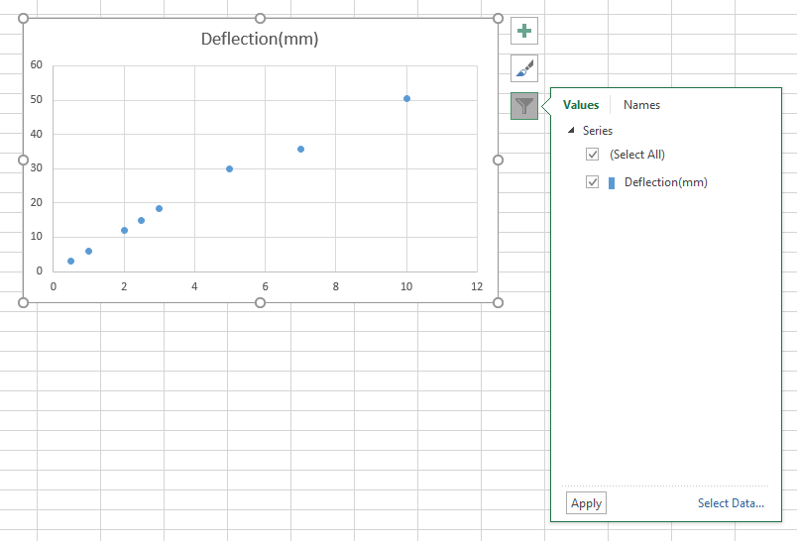
Making a Plot: Part 2
Excel will select data automatically that it thinks is right.
To adjust what data is being plotted, click on “select data” as shown

Slide 5
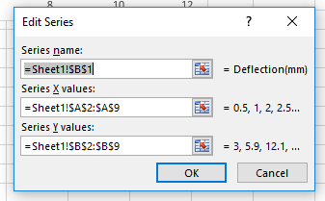
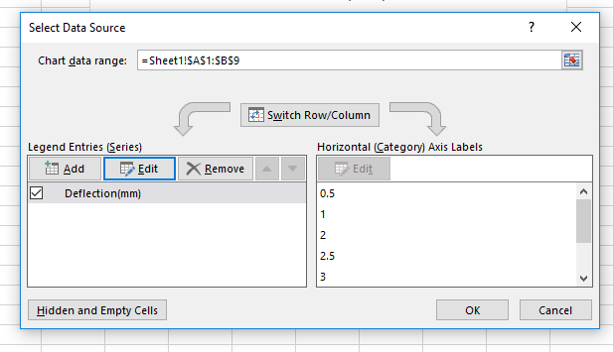
Making a Plot: Part 3
A popup menu will appear as shown below.
Select the “Edit” option. The menu on the right will appear.
Click one of the shown buttons, then hold the left mouse button and drag to select the data you would like to be plotted on the corresponding axis. Press “Enter” on the keyboard to confirm your selection.

Slide 6
Making a Plot: Part 4
To plot additional sets of data on a single graph, select “Add”. When you are finished selecting the data, click “Ok”.
When plotting multiple data sets on a single graph, the data points from each set will be differentiated by different colors on the graph. You will need to change the shape of the data points by using the options in the sidebar, as the colors will not show up when you print your graphs.

Slide 7
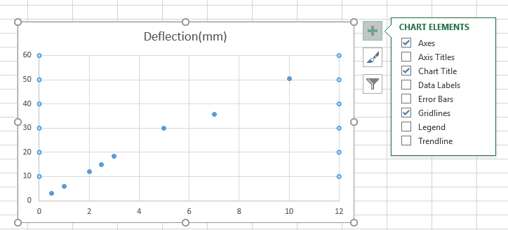
Making a Plot: Part 5
Change the upper and lower bounds of the axis so that your data fills up the graph by selecting them and using the sidebar.
Select the graph and click the plus symbol to bring up the shown menu.
Click the appropriate box to add things to your graph. Clicking the “Chart Title” box will add a title if one is not there already.
Double clicking the title text on the graph also allows you to edit the title.
Similarly, double click the axis title text with the left mouse button when it appears on the graph to edit it.

Slide 8
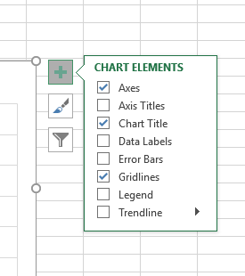
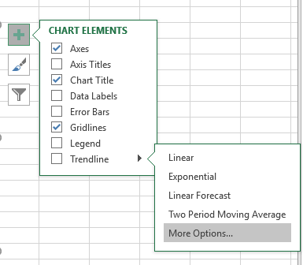
Making a Plot: Part 6
On the menu that appears, select “More Options”.
Then in the sidebar you can set the type of trend line and adjust any other settings like displaying the equation of the line or the r-squared value.
To add a trendline, hover the mouse over “Trendline” and click on the little arrow that appears.

