Slide 1
Regression Analysis in Microsoft Excel
MS&T Physics 1135 and 2135 Labs

Slide 2
Background
Often, we seek to derive a value for some physical constant from our measured data by fitting a trendline to a plot. These trendlines are found by regression analysis.
Additionally, sometimes there’s no obvious way to determine the error involved in the measurement. In these instances, an estimate of error can still be obtained using statistical methods. In Excel, the Analysis ToolPak add-in provides a Data Analysis feature with many useful functions.
This tutorial covers adding and editing plots and trendlines, calculating averages and standard deviations, and using the Regression tool in Data Analysis to find quantitave estimates of error in calculated values.

Slide 3
The Data
a | b=5a | c=a*b = 5a^2
0 | 0 | 0
0.1 | 0.5 | 0.05
0.2 | 1 | 0.2
0.3 | 1.5 | 0.45
0.4 | 2 | 0.8
0.5 | 2.5 | 1.25
0.6 | 3 | 1.8
0.7 | 3.5 | 2.45
0.8 | 4 | 3.2
0.9 | 4.5 | 4.05
1 | 5 | 5
1.1 | 5.5 | 6.05
1.2 | 6 | 7.2
1.3 | 6.5 | 8.45
1.4 | 7 | 9.8
1.5 | 7.5 | 11.25
Consider the table excerpt at right.
The first column (a) is a list of numbers increasing by a fixed amount. This will serve as our independent variable in the discussion to follow.
The second column (b) is simply 5 times the first: b = 5a.
The third (c) is the product of the first two: c = ab = 5a².

Slide 4
Adding a Plot
Do not use line plots, as they won’t provide accurate trendlines. Do not use the various connected scatter plots, as the connections obscure trendlines.
In the Insert tab, select the disconnected scatter plot.

Slide 5
Adding Trendlines
Here we have a plot with two series, B vs A and C vs A.
Make sure your plots have appropriate titles and legends.
Trendlines can be added to each series by right clicking and choosing Add Trendline.

Slide 6
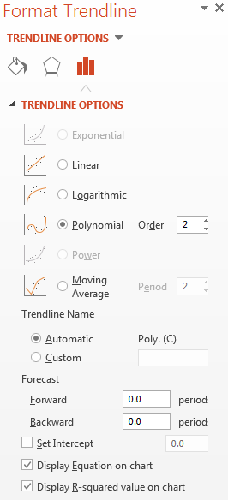
Notes on Trendlines
Any trendline you add should have the equation displayed on the chart. The R² value is optional, but can tell you how well the line fits the data.
Sometimes your equation will have peculiar terms that are statistical artifacts; the quadratic trendline on the previous slide is a good example. Set Intercept can fix this, but usually isn’t necessary.
Choose the trendline that best fits theory, even if it doesn’t fit the data particularly well. Comparing the trendline equation to theory provides experimental results, and this can only be done if the two have the same functional form.

Slide 7
Simple Statistics
You will often need to calculate average values. Type “=average(<range>)” in a cell to calculate the average value of the cells in <range>.
You can use standard deviation as an estimate of measurement error when there is no obvious error associated with the measuring device (i.e. our triple beam balances). Type “=stdev(<range>)” in a cell to calculate the standard deviation of the cells in <range>.
In both cases, you can select the range by clicking and dragging or by using the arrow keys on the keyboard while holding the shift key. You can also hold the control key while clicking to select a discontinuous range, but many Excel functions cannot use discontinuous ranges as arguments.

Slide 8
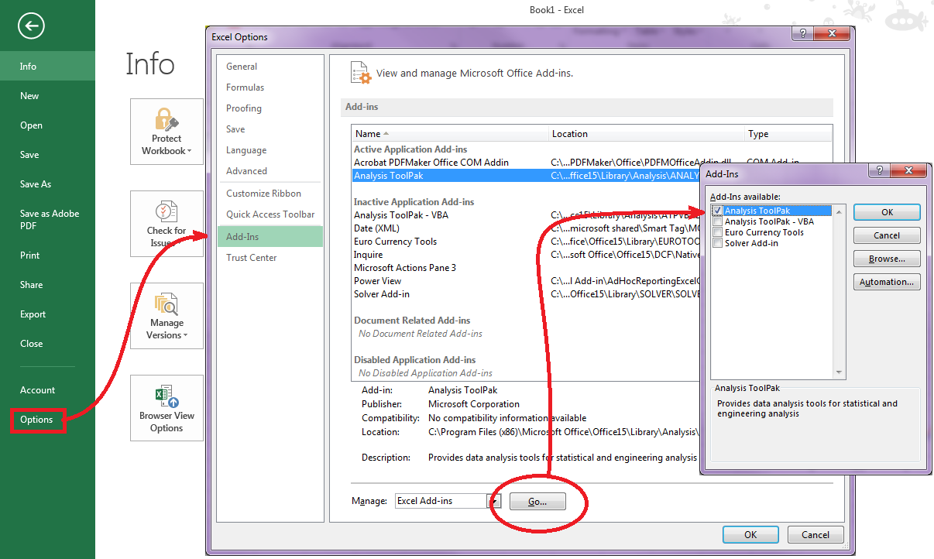
Adding the Regression Analysis ToolPak
You will likely have to add the Analysis ToolPak the first time you use it.
Click File>Options to bring up the Options Dialogue.
In the Add-Ins tab, click Go… and check the box for Analysis ToolPak in the Add-Ins Dialogue. Click OK.

Slide 9
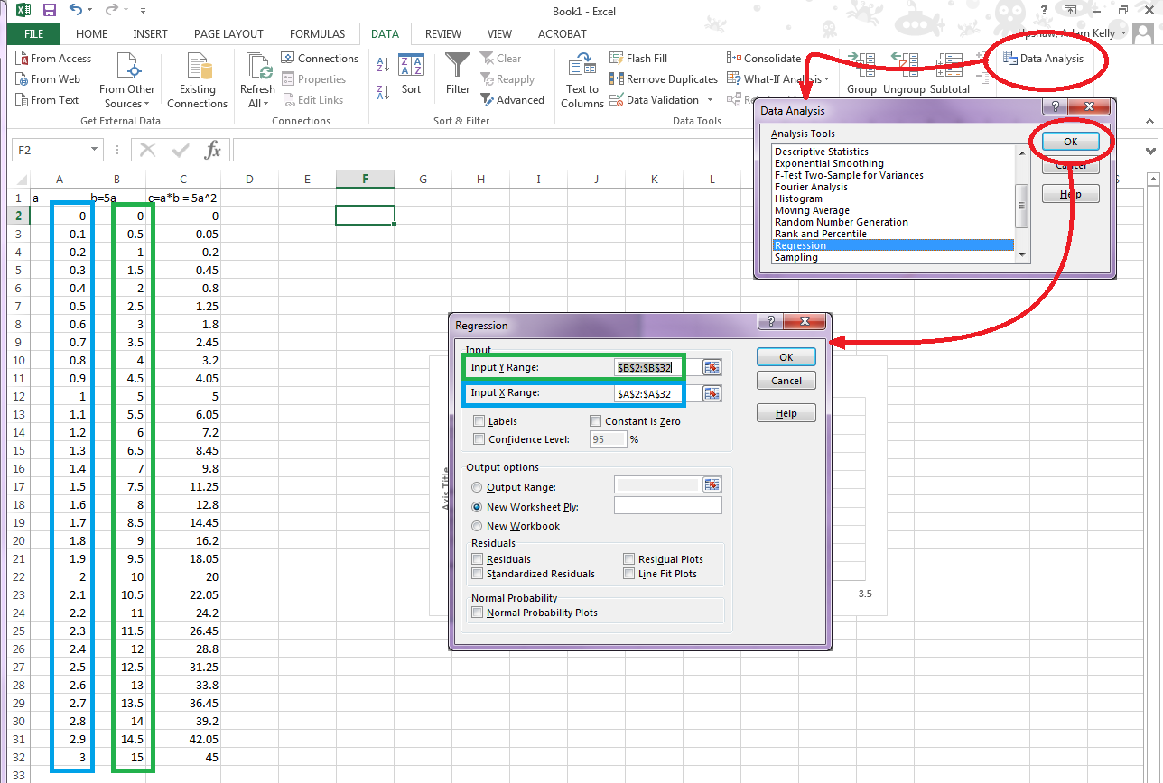
Linear Regression: Input
In the Data tab, Click Data Analysis, choose Regression in the dialogue that pops up, and click OK.
The Regression dialogue asks you to specify the X (blue) and Y (green) ranges.
Since it’s only being given one column in the X range, Excel will calculate a linear regression analysis.

Slide 10
Linear Regression: Output
SUMMARY OUTPUT
Regression Statistics
Multiple R | 1
R Square | 1
Adjusted R Square | 1
Standard Error | 1.25E-15
Observations | 31
ANOVA
 | df | SS | MS | F | Significance F
Regression | 1 | 620 | 620 | 3.95E+32 | 0
Residual | 29 | 4.55E-29 | 1.57E-30
Total | 30 | 620
 | Coefficients | Standard Error | t Stat | P-value | Lower 95% | Upper 95% | Lower 95.0% | Upper 95.0%
Intercept | 1.78E-15 | 4.39E-16 | 4.042467 | 0.000356 | 8.78E-16 | 2.68E-15 | 8.78E-16 | 2.68E-15
X Variable 1 | 5 | 2.52E-16 | 1.99E+16 | 0 | 5 | 5 | 5 | 5
Here is the output. The only parts we want are the cells in the green box.
This is all based on y=mx+b
X Variable 1 is slope: m=coefficient, Δm=standard error.
Intercept is y-intercept: b=coefficient, Δb=standard error.

Slide 11
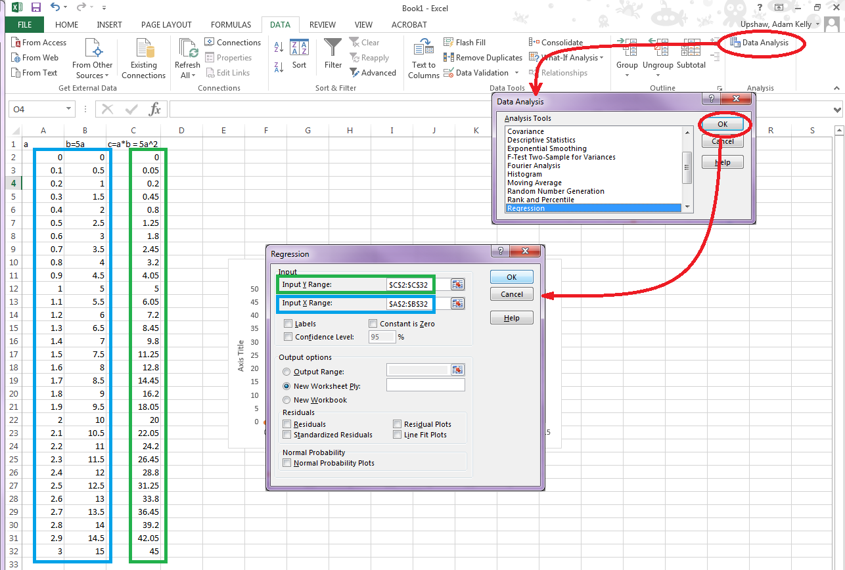
Quadratic Regression: Input
Repeating the process, we can also perform higher order polynomial regressions.
This time, the X range contains two columns. Excel will now calculate a quadratic regression analysis.

Slide 12
Quadratic Regression: Output
 | Coefficients | Standard Error
Intercept | -7.25 | 1.295183385
X Variable 1 | 0 | 0
X Variable 2 | 3 | 0.14832397
Here is the important part of the output. The rest has been left off.
The relevant equation now is y=ax²+bx+c
The regression algorithm used in Excel assumes the first column of X corresponds to the linear term and the second is the quadratic term: y=ax₂+bx₁+c
Our data wasn’t set up that way; it was a product: y=5x₁x₂
Excel fit our column c to a linear combination of columns a and b instead of a product, so it got different coefficients, but still fit the data remarkably well with an R² of 0.933803694.

