Slide 1
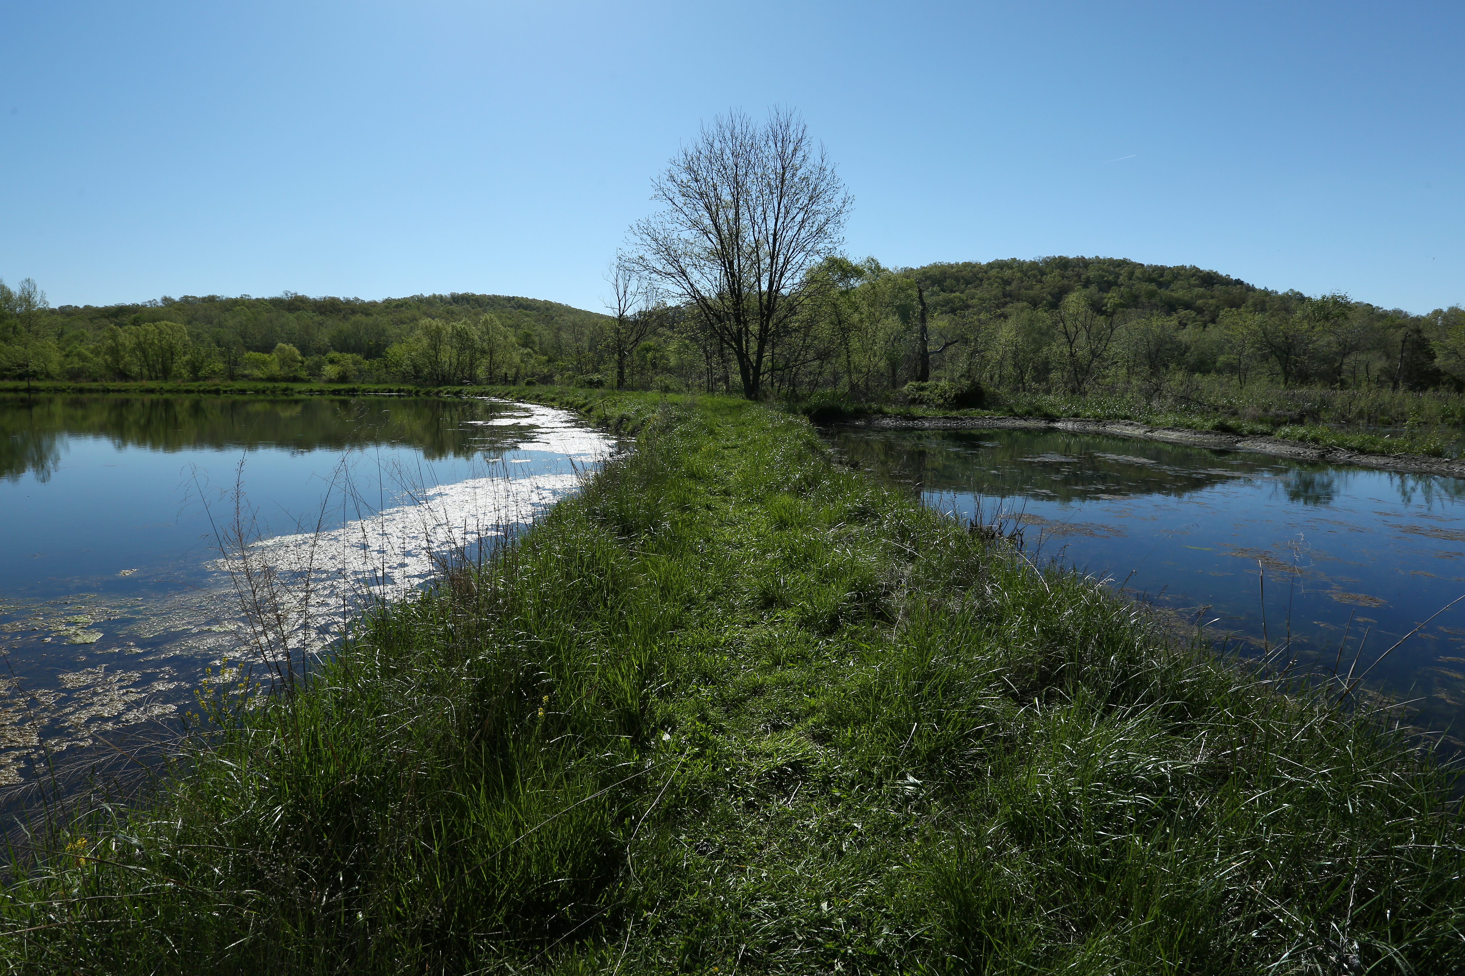

Slide 2
FONTS
YOU NEED TWO FONTS TO USE THIS TEMPLATE
Contact IT to have Tungsten and Orgon Slab installed on your machine
You may need to close PowerPoint and re-open in order to access the fonts.
All templates themes include this brand font

Slide 3
ABOUT THIS THEME
A Missouri S&T color palette is built into this theme.
There are five layout styles in this theme.

